Slide 1
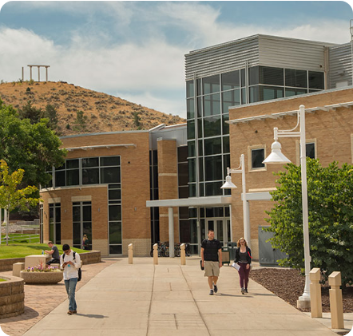
IDAHO STATE UNIVERSITY
Executive Leadership Vision
EXECUTIVE PRESENTATION
Institutional Planning &
Financial Sustainability
Aligning Resources, Operations, and Transparency for ISU's Long-Term Success
Carson Howell, PhD
Pocatello • Meridian • Twin Falls • Idaho Falls

Slide 2



LEADERSHIP PROFILE
About Me
20+ Years Experience
Academic Background
Core Specialization
18 Years in Higher Ed
Grew up in Sugar City
11 Yrs
7 Yrs
Positions at other institutions and at state systems.
Finance & Budgeting
Institutional Research
AS: Biology Education
BS: Microbiology
MPA: Master of Public Admin.
Deep expertise in state funding models, budget transparency, and innovation.
PhD: Public Policy & Admin.
Former Chief Financial Officer & Chief Research Officer at the Idaho State Board Office.
Notes:
Grew up just up the road in Sugar City
Earned an Associate in Biology Education
Bachelor in Microbiology
Made the logical transition to public administration and higher education
20+ years in public service with 18 in higher education
Worked at institutions and system offices in Idaho, Utah, and now Oregon
CFO and CRO at the Idaho State Board office
My focus has been in budgeting and finance 11 years and IR 7 years
During my time in higher ed, I’ve also focused on innovations at the institution and system level
Direct Admissions, Apply Idaho, 14 for Free (Snow)
Non-LinkedIn story - hurdle
Prompt: Share my vision for financial sustainability and institutional planning at Idaho State University, including how I would align resources with strategic priorities, strengthen operational effectiveness, promote transparency, and position the university for long-term success.

Slide 3
PLANNING VISION
Vision for Institutional Planning
Strategic Plan Timing Has Changed
Iterative Planning & North Star
Next Strategic Plan
Long strategic plans create critical vulnerability. Agentic AI, value of a degree, and COVID all have changed within 10 years.
Iterative framework prioritizing nimbleness, decisive action, and shared governance—always locked onto our institutional North Star.
Embarking on ISU's new strategic plan as early as next year, establishing dynamic framework that allows us to be forward-thinking and responsive to external pressures and opportunities.
Agility over rigidity: continuous planning allows ISU to capitalize on emerging regional and educational trends.
Notes:
It all starts with a plan
Questions of where are we going, why are we doing it, and how we are doing it.
Who are we?
Institutional planning has been disrupted
Timelines for strategic plans are shorter
We don’t want to be locked into multi-year plans in this rapidly changing environment
My vision involves shortening the process
More iterative
Prioritize nimbleness, decision making, shared governance, boldness
Vision and mission are crucial
Those are our North Star – our guiding principles and the filter through which we run everything
Agility over rigidity
Once we’ve developed that plan, now we turn to how we fund it

Slide 4
FINANCIAL VISION
Vision for Financial Sustainability
Fiscal Year 2025 Revenue Context
Financial Philosophy
"Money will always be a constraint—it shouldn’t be THE constraint."
2025 Revenue Sources Breakdown
State Appropriations
35.45%
Student Tuition & Fees
18.27%
Timely Decision Tools
Grants & Contracts
14.59%
Equip budget holders, administration, the Board, and the public with clear, real-time metrics to drive our core mission.
Gifts & Capital Grants
9.99%
Educational Activities
6.80%
Title IV & Other Federal Grants
5.93%
SOU MODEL
SNOW MODEL
Auxiliary: 4.29%
Other Operating: 3.19%
Investment Net: 1.49%
Monthly Financial Reports
Internal Budget Dashboards
Notes:
The chart on the right is from our last audited financial statements
We are most reliant on state appropriations and then tuition and fees, then grants and contracts
Those funding streams can be volatile
We’ve enjoyed increased enrollments the last few years
But those enrollments can fluctuate
We’re now back to where we were in the fall of 2016 (13k in 2025, 13k in 2016, dipped to 11.7k)
State funding can also be fickle
We just went through $8M in budget corrections
We need timely tools to make decisions
At Snow we launched an internal tool
At SOU we launched an external tool
I want to ensure that tools are in place and people are trained
Money will always be a constraint, but it shouldn’t be THE constraint
So where do we spend it?

Slide 5
STRATEGIC RESOURCE ALLOCATION
Aligning Resources with Strategic Priorities
Intellectual Vigor, Cultural Vitality, & Community Health
Investing in research opportunities and learning activities that directly relate to our mission.
ADAPTABILITY CASE STUDY
Evolutionary Catalog Shift
Inspiring Knowledge & Discovery
2008–2009 CATALOG
Single 3-Credit Course in Artificial Intelligence
Funding programs and activities that are exciting and get students and employees more deeply invested in our work.
Driving Institutional ROI
2026–2027 CATALOG
Bachelor of Science in AI Sciences
Leverage existing models of return and promote bold, new ideas. We must build feedback loops into our financial analyses.
Notes:
Now that we have an institutional plan and a sustainable revenue stream, how do we spend the money?
This is where we go back to our North Star – the mission and vision
Our mission is we engage students through learning and research opportunities that improve the intellectual vigor, cultural vitality, and health of our communities
Our vision is to inspire a passion for knowledge and discovery
Collaboration is important as we discuss options because priorities can change
Look at this evolutionary shift in our catalog
We need regular discussions on priorities - as aligned with the vision and mission
We also need to think about things that will result in additional resources
If we are creating a new biology education degree, is it a biology degree or an education degree
A deep understanding of the state funding model shows that we earn more money as a biology degree
However, if the model changes, then we need to be nimble and responsive
But we want to best utilize those scarce funds, so it’s important that our systems and processes are effective and efficient

Slide 6
EFFECTIVENESS
Strengthen Operational Effectiveness
STAGE 1 • EFFECTIVENESS
STAGE 2 • EFFICIENCY
Desired Outcomes
Speed & Fine-Tuning
Effectiveness is a system tuned to accomplish the desired outcome.
Efficiency is a system tuned to reach outcomes quickly, economically, and with minimal friction.
GOVERNANCE DISCIPLINE
Rule & Exception Control
Clear rules must exist and be adhered to. Exceptions bog down systems—if everything is an exception, there is no process.
Notes:
Effectiveness is a system tuned to accomplish the desired outcome
We know we can get what we want, but it may take time
An efficient system is one that is tuned to reach outcomes quickly, economically, and with little friction
This is why it’s important to design systems and processes around the desired outcome (effectiveness)
Then we optimize (efficient)
This requires regular reviews of systems and processes
Rules and policies are important
We also must monitor exceptions
Exceptions can bog down a system
But those exceptions provide us opportunities to see where we can better tune the process
If we rely on and manage by exception, we’ll NEVER be effective or efficient
Those reviews and tweaks to our system must be thoroughly communicated

Slide 7
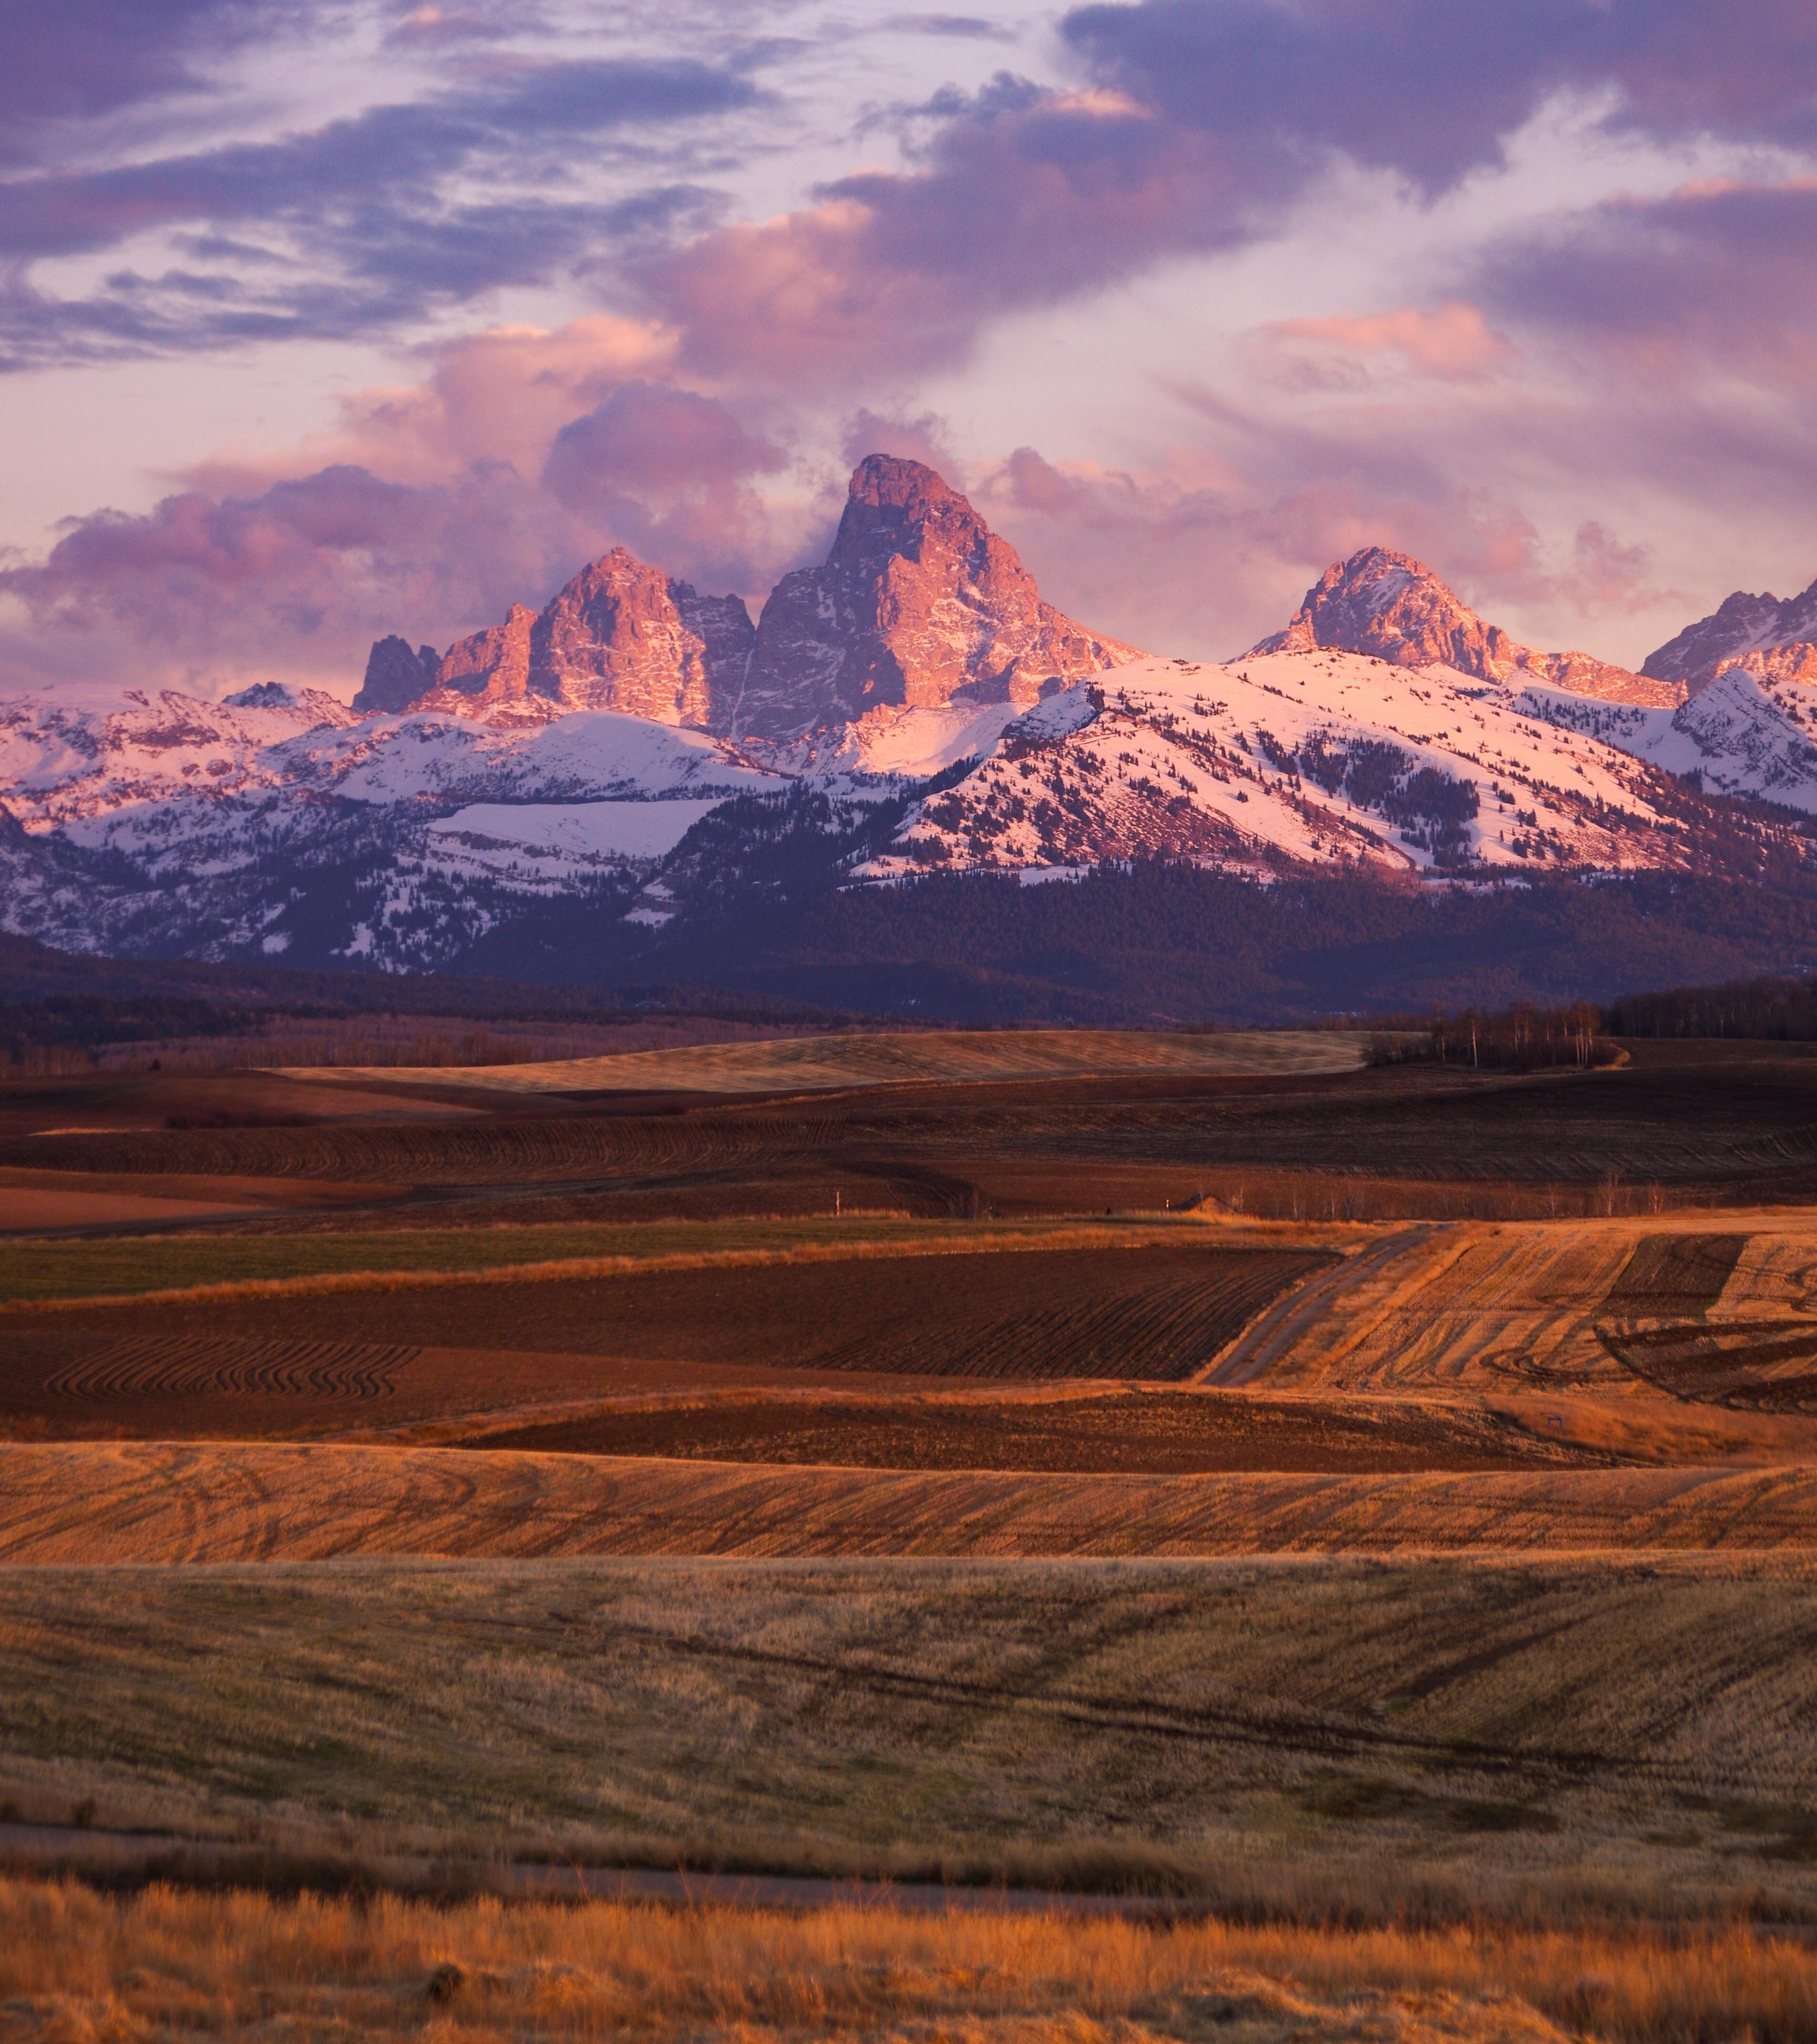
TRANSPARENCY
Promote Transparency & Break Down Silos
"Silos are great for farming here in southeastern Idaho, but they are terrible for higher education."
WARNING:
Efficiency without downstream transparency creates downstream errors.
Regular Dean Engagement: Direct, recurring alignment sessions
Joint Divisional Strategy: Finance & Admin paired with Academic Affairs
Notes:
My first job was in the potato fields up by St. Anthony
Silos are great for farming, but terrible for higher education
We must communicate, especially around changes
I hold regular feedback sessions
At Snow, I met 1:1 regularly with the Deans
At SOU, the Finance team meets with the Academic and Student Affairs teams each month (director level)
I attend staff assembly and faculty senate
I was on a call with a VP of Finance and Admin who said they meet with their provost quarterly
Not sufficient
I commit to transparency and welcome feedback
Without that feedback, we can cause downstream problems
PowerBar story
We could speed up the mixers, but it caused downstream effects if it wasn’t communicated
It’s the different perspectives that help make better decisions and drive real improvement
That collaboration will make all the difference as we move ISU forward

Slide 8
FUTURE OUTLOOK
Position ISU for Long-Term Success
Overcoming Higher Ed Paradox
Higher education often opposes two things: change and the way things are.
Unmatched Expertise Footprint
ISU possesses the broadest collection of talent in southern Idaho—stretching east-west from Meridian to Idaho Falls.
Collaboration as the Mechanism
No problem exists that cannot be solved by engaging both our students and our network of Bengal experts.
"Skills from Anthropology to Welding — From Nails to Nuclear."
Notes:
There is not a broader group of experts across southern Idaho than at ISU – anthropology to welding; nails to nuclear
There isn’t a problem that exists that can’t be solved by engaging our students and our colleagues
And we have some big issues to solve
Paradox: Oppose two things– change and the way things are
This paradox really only has one solution – we MUST innovate
It is about the culture we’re building
I want a culture of:
Data
Decision-making
Nimbleness
Boldness
Transparency
Shared Governance
Engagement
Collaboration
Partnerships
Discovery
Risk-taking
Fun
Emphasize the experience, both for the student and the employee
Being a Bengal means something

Slide 9



IDAHO STATE UNIVERSITY
Why ISU?
VALUES: Integrity, Inclusivity, Shared Responsibility, Community, Teamwork, Learning
Self Aware
Caring
Innovative
ISU knows exactly who it is and plays directly to its distinctive regional and research strengths.
Deeply student-centered and employee-focused across every campus and administrative department.
Unafraid of big ideas and boldly leading the future of public higher education.
Building ISU's Sustainable Future Together
Roar Bengals Roar!
Notes:
Coming back to where we started
There are lots of qualified individuals, but you’re looking for qualified and the right fit
When I look at ISU, this is what I see
An institution that knows who it is and plays to its strengths
An institution that cares about people
And an institution that is not afraid of big ideas and being a leader
That’s exciting
That’s what I’m interested in
It’s a good fit
Top three Clifton Strengths are
Futuristic
Strategic
Ideation
Those same things that drive me are what I see at ISU
I love the focus on the future
I love the strategic thinking and direction
And I love big ideas and dreams
So I’m here because it’s a good fit
In fact, it’s a great fit
This is a team and a university that I would love to be a part of
Thanks for the opportunity to visit today and I’m happy to answer your questions

