Slide 1
Energy Growth in Idaho: Balancing the Transition
January 2026
Nathan Murray, Economic and Community Development Advisor

Slide 2
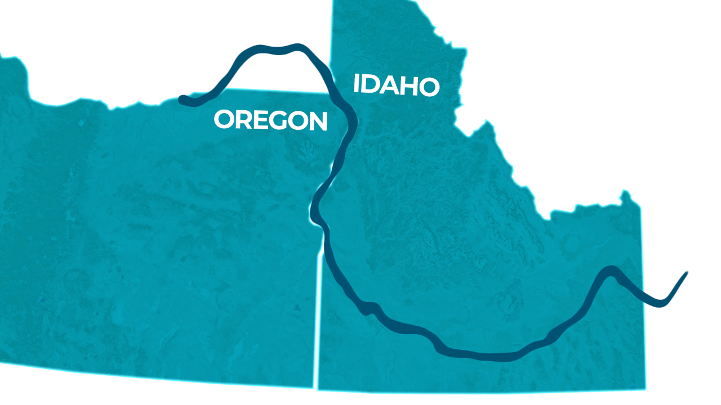
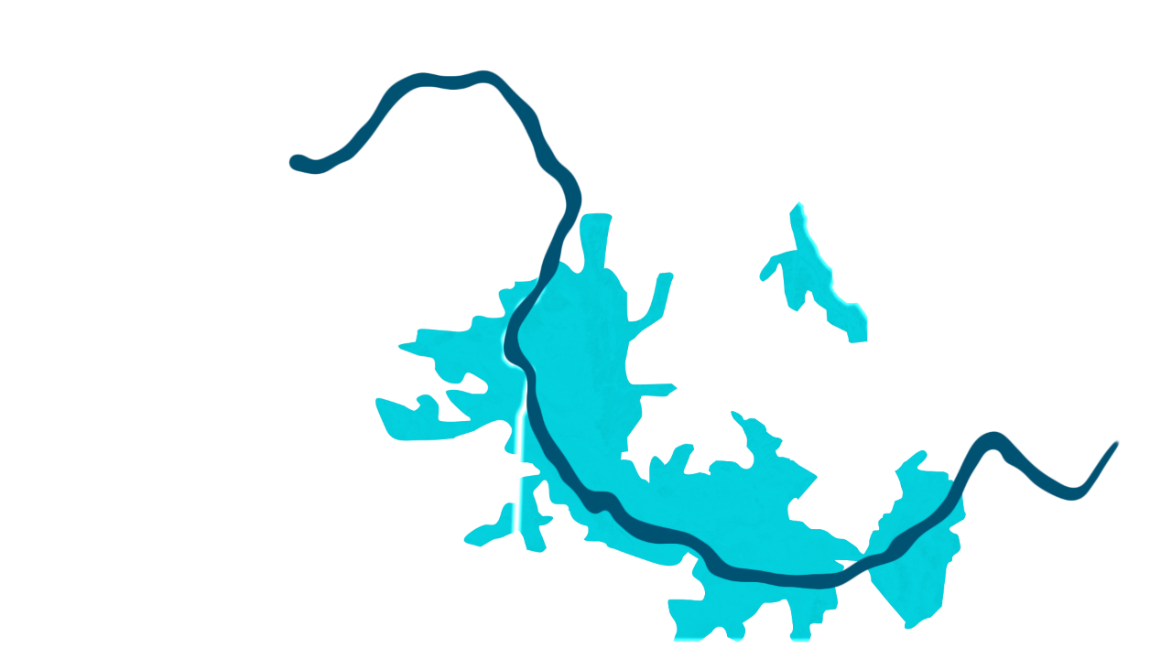
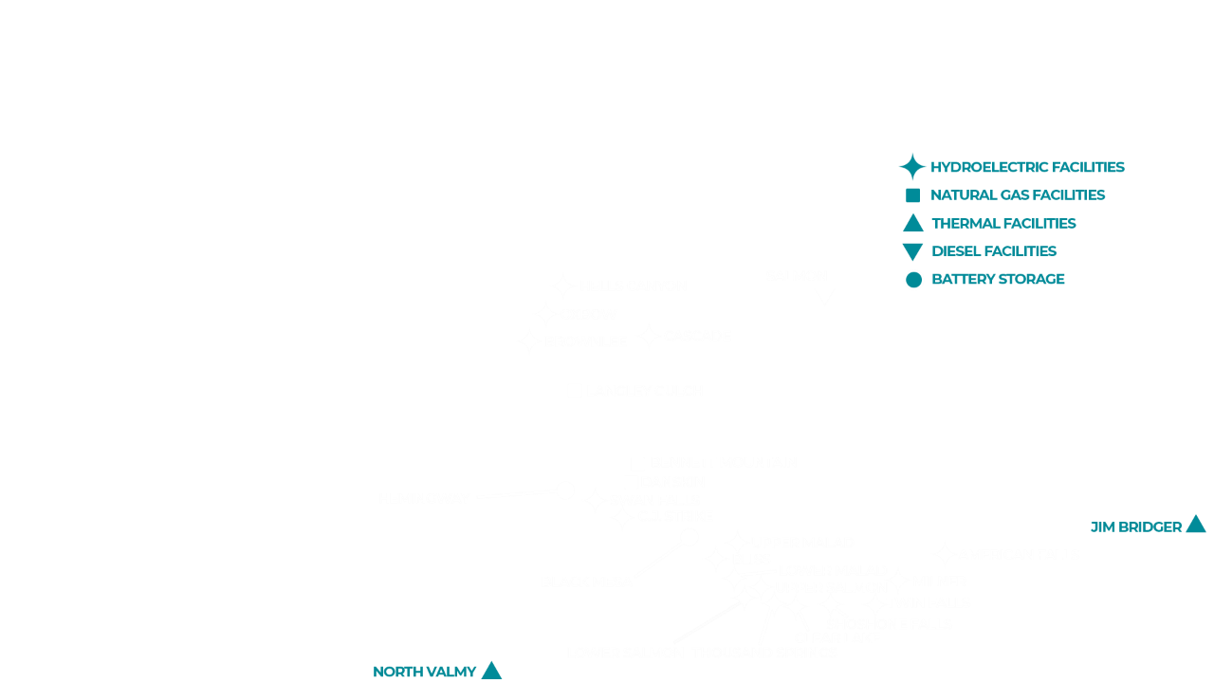
Our Service Area
More than
650,000
customers
Notes:
This is our service area. We’ve proudly served customers in Idaho and Oregon for over 100 years – since 1916.
Our Regional Operations Centers are located to provide timely restoration activities when needed but also provide front line customer service to our communities. A few offices are minimally staffed with only a line crew, while the other locations include customer relations (or energy advisors), Field Services (metering and specialized linemen-Troublemen and Patrolmen), Design Services, Field Engineers, Schedulers, material services, mechanics, Safety Professionals and others all in place to provide localized support to our customers.
Across these regional offices we have a total of over 600 employees including around 30 regional line crews.

Slide 3

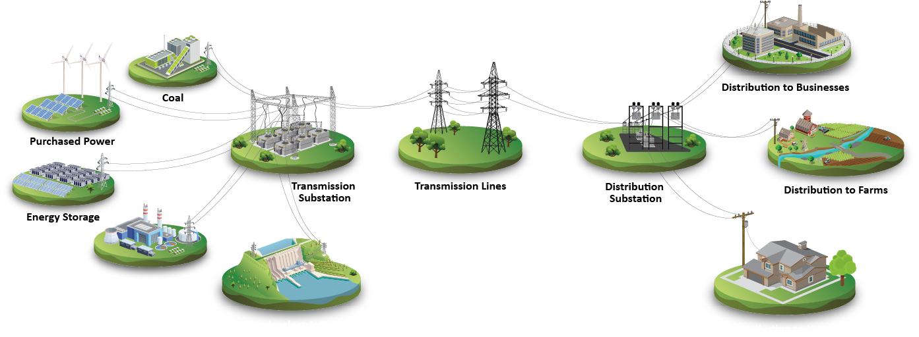
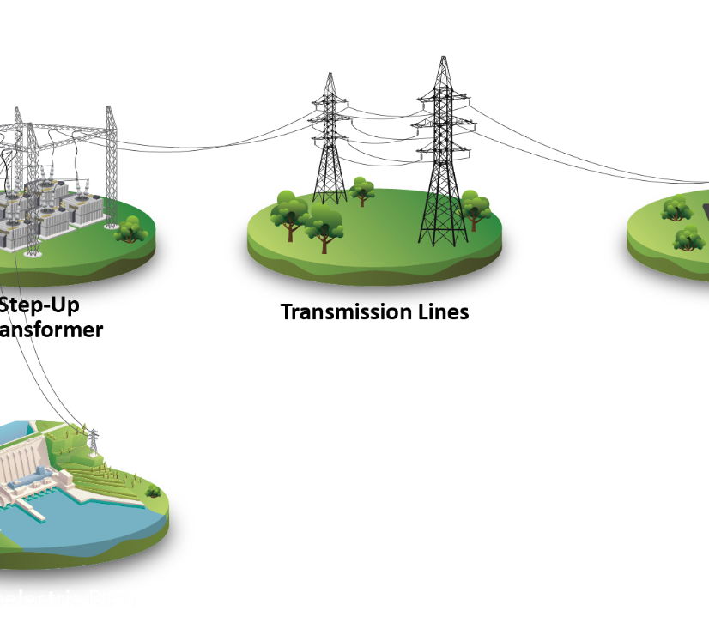
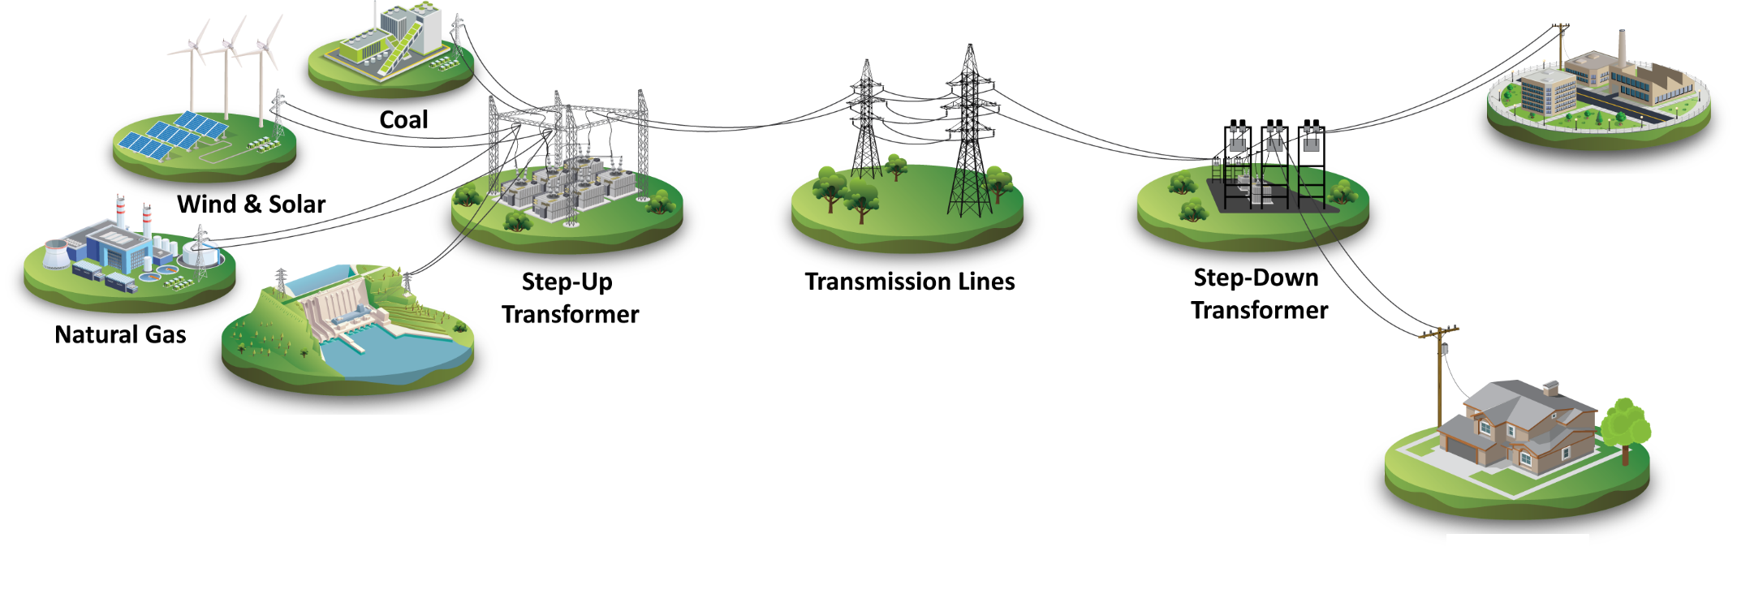

Serving Customers
Notes:
Electricity is the same regardless of whether it comes from a hydroelectric dam, coal or gas plant, solar, wind or other source. Idaho Power’s largest energy source comes from clean hydropower.

Slide 4
Path Toward 100% Clean Energy Coal’s Share of Idaho Power’s Generation Capacity
*
*
*Projected, based on 2023 Integrated Resource Plan
Notes:
Nameplate coal capacity compared to total nameplate capacity of all Idaho Power resources, as reported in the annual report.
The drop in 2010 is the result of adding the two single-cycle gas plants (Danskin and Bennett Mtn.) after 2005, which increased total generation capacity. The drop in 2015 is the result of adding Langley Gulch (2012), which added to total generation capacity.
The drop in 2020 is the result of exiting Valmy 1 at the end of 2019.
The drop in 2023 is the result of Boardman shutting down in October 2020.
The drop in 2026 is the result of two Bridger coal units (in 2024) and Valmy coal unit 2 (in 2026) being converted to run on natural gas (without a net drop in total generation capacity because those units will convert to natural gas).
The drop in 2030 is due to the remaining Bridger coal units being projected/forecasted to be converted to Natural Gas by 2030 (meaning all coal would be offline by 2030).

Slide 5
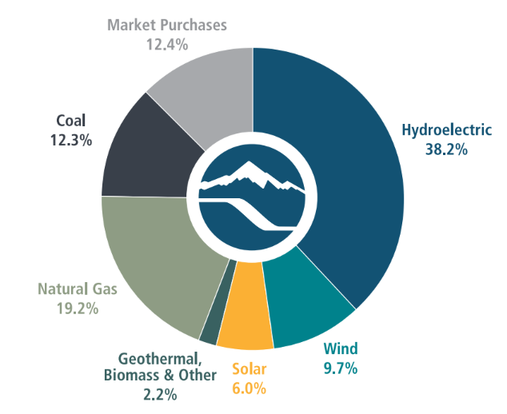
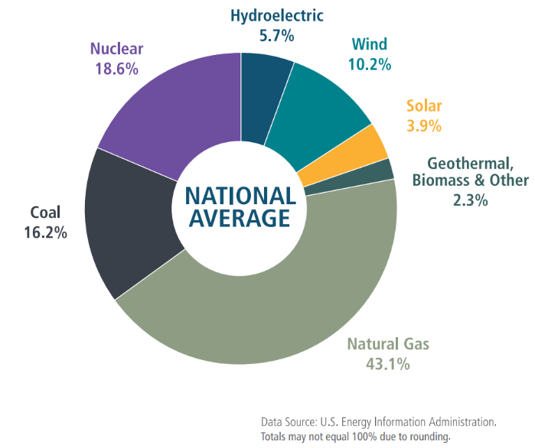
A Tradition of Clean Energy
2024 Energy Mix
Notes:
Idaho Power has a rich history with clean energy
Hydro fluctuates with how much precipitation we get, and also is adjusted based on other piece of the pie growing.
Still much better than the national average from a clean portfolio perspective

Slide 6
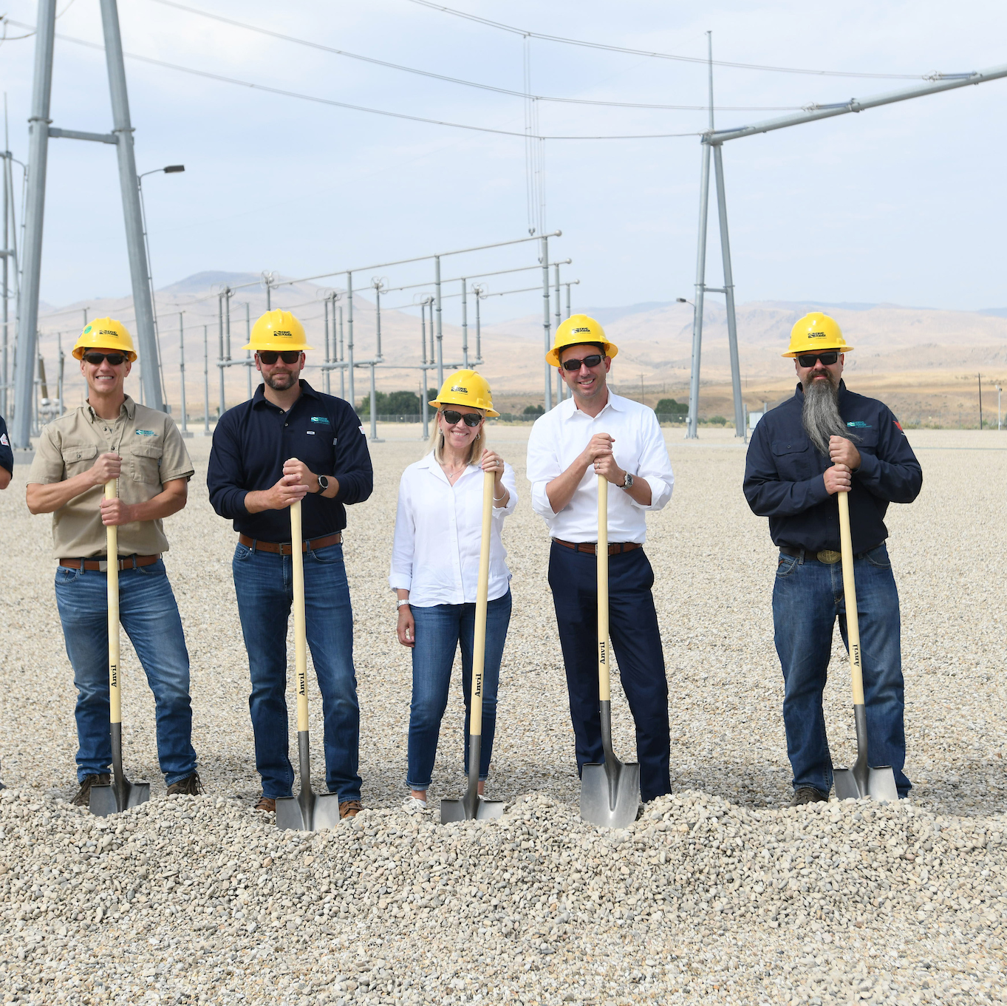
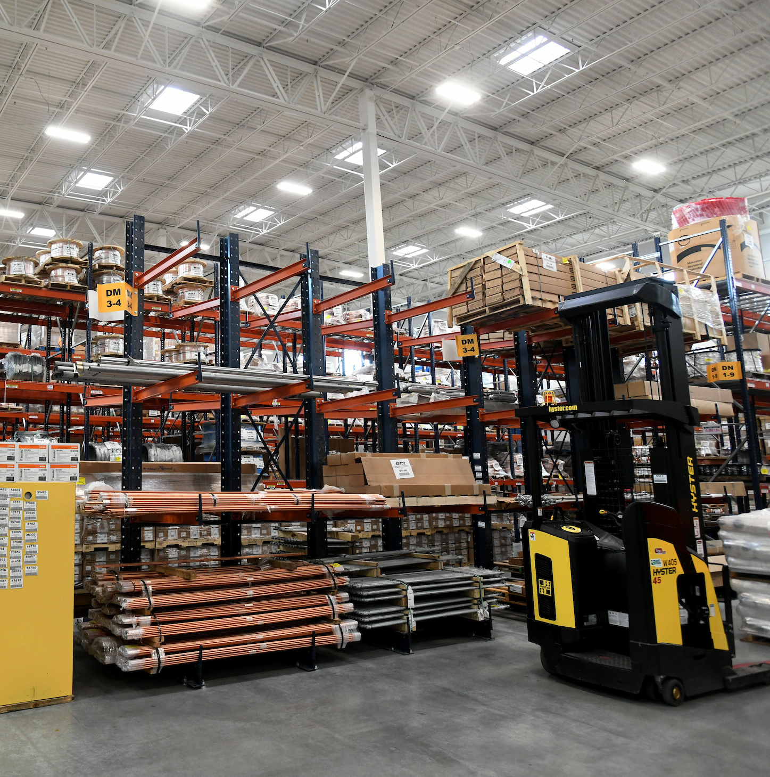
Our Growth
2025 Preliminary IRP Load Forecast vs. Prior IRPs
 | 5-Year Forecasted Annual Growth Rate |  | 20-Year Forecasted Annual Growth Rate
 | Retail Sales (Billed MWh) | Annual Peak (Peak Demand) | Retail Sales (Billed MWh) | Annual Peak (Peak Demand)
2025 IRP | 8.3% | 5.1% | 2.7% | 1.9%
2023 IRP | 5.5% | 3.7% | 2.1% | 1.8%
2021 IRP | 2.6% | 2.1% | 1.4% | 1.4%
Notes:
What will it take to get to success with 8.3% - supply chain intact, transmission getting built, etc. IRP models show how the 8.3% looks in MWs and what we’re going to have to be building to meet that. It’s a big number – how are we planning for that? Yes, we have to build all this, but that presupposes we get all the parts, we get the approvals, etc.

Slide 7
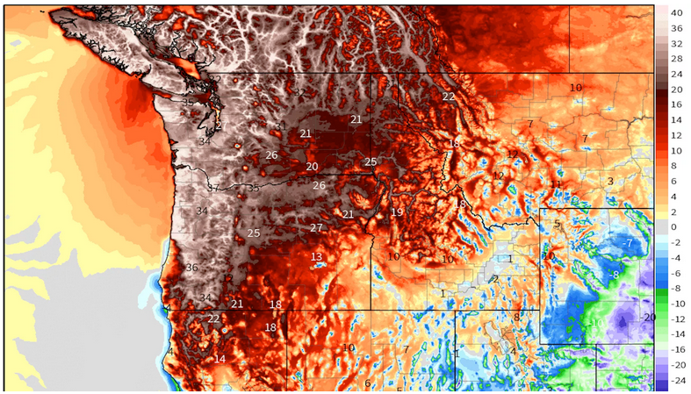
Notes:
Do you all remember the heat dome of 2021?
Days like this are tough
This is a map of the pacific northwest on June 30, 2021
The numbers represent the temperature above average
This was a 1-1000 year event.
This is a pretty scary illustration of the heat dome we all experienced on June 28th.
The white reflects where temperatures were over 40 degrees above average.
You have all heard the stats. It was a 1-1,000-year event.
Death Valley was the only area in the US with hotter temperatures that day.

Slide 8
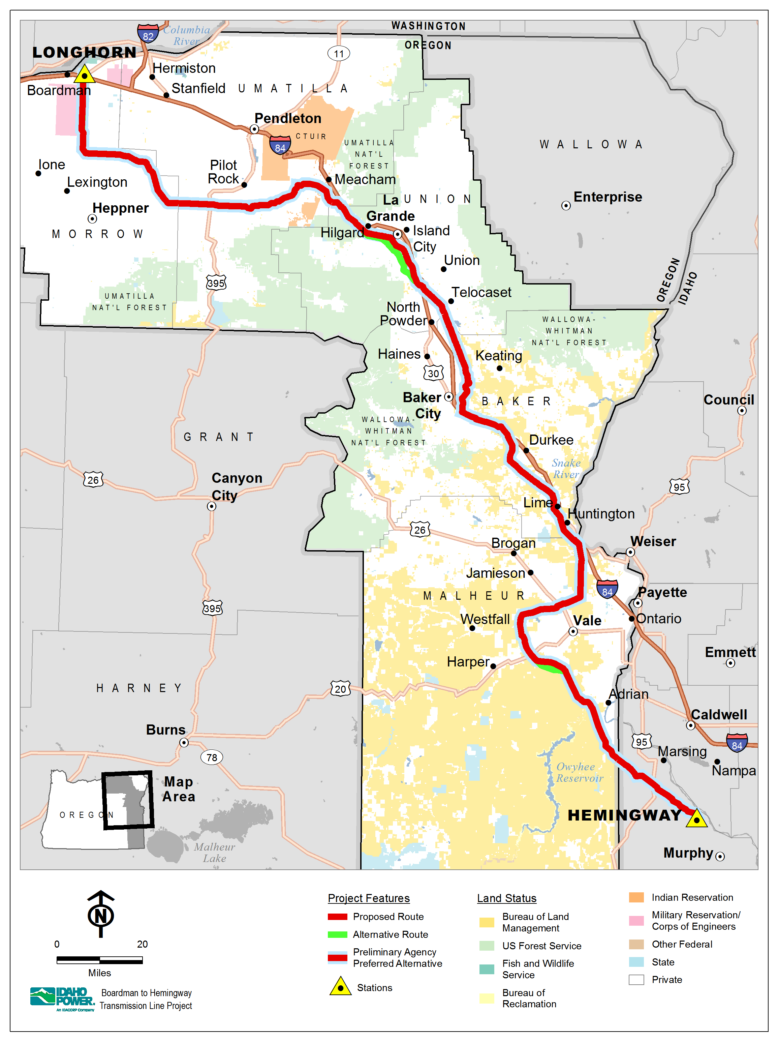
A Case Study: Boardman to Hemingway
290-mile, 500 kV transmission line
Project initiated in 2006
Construction duration: 30 - 36 months
Cost: $1.5-1.7B ($200M+ permitting)
Diversity in peak considerations
20 Years and counting to completion: construction began summer 2025
Notes:
Let's take B2H as an example.
B2H runs from Idaho to Oregon.
It will connect us with the Mid-C market.
It will allow us to use Hydro in June when we need it, and sell hydro in the winter when PNW need it.
This line is 19 years old, and we still don't have a permit to construct.

Slide 9












Technology Cost: Declines 2010-2020
85%
49%
85%
(Source: Bloomberg NEF)
Notes:
First, we believe it’s achievable. This is a look at the decline in prices for these technologies over the past decade.
Remarkable. I would have never guessed this.

Slide 10
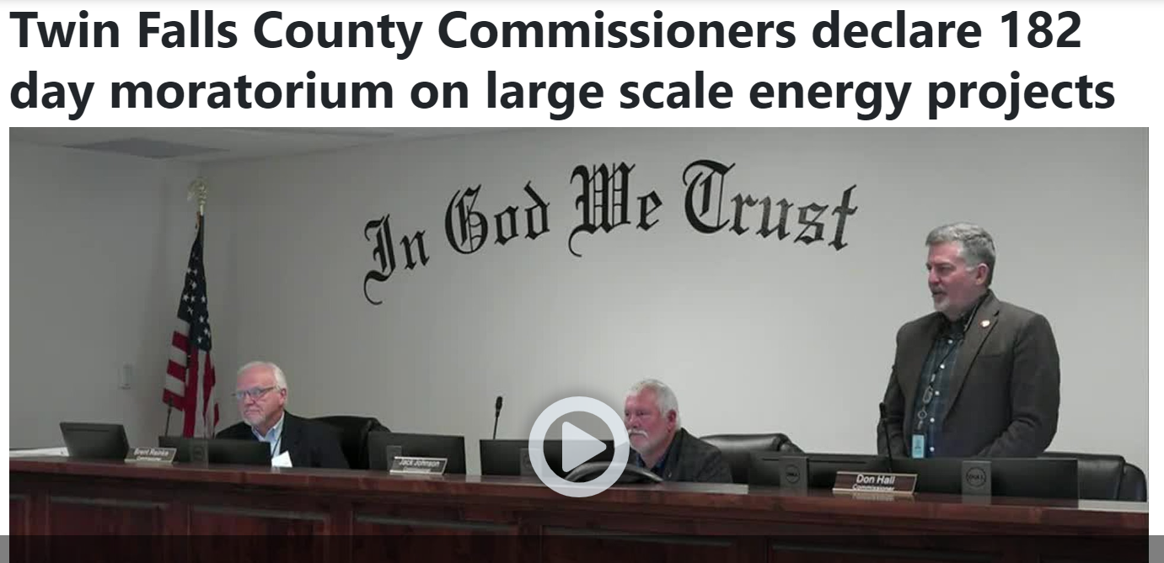
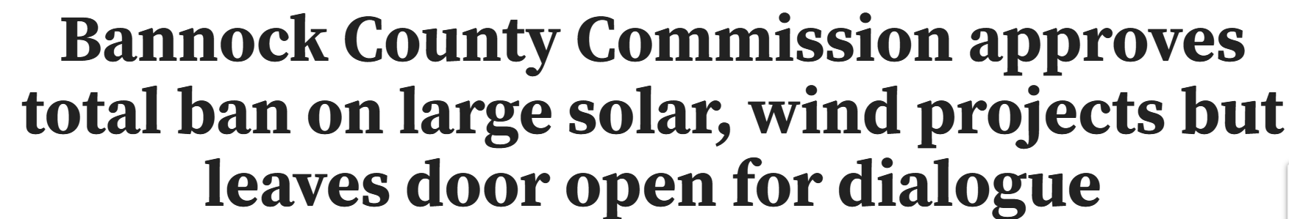
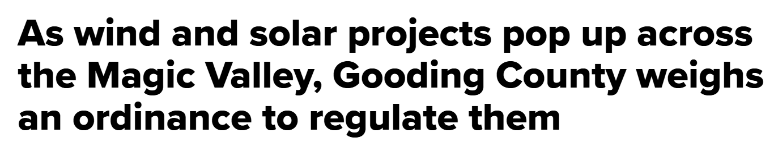
Renewable Energy Lead Times (Including Permitting)
Notes:
But can we even achieve the clean future in a balanced way?
This continues to be a challenge for us as communities close the door to generation resources at a time when we are needing to onboard generation.

Slide 11
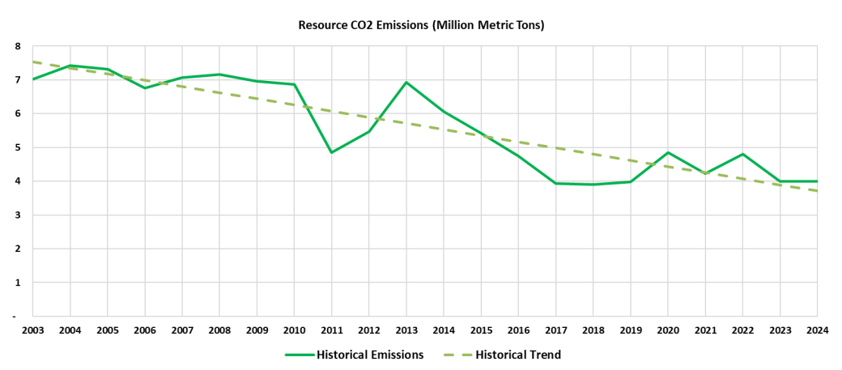
The Good News on the Clean Front: Cost Effective Reductions
Notes:
Source: 2025 IRP

Slide 12

It’s All About Balance…
Notes:
So as we think about all of this…the challenges, the opportunities and options for moving into the future, it really comes back to balance.
We have to focus on safety, reliability, affordability and a clean portfolio in that order. We can’t sacrifice reliability on our way to clean energy.
Hopefully this helps you understand what is going on on our side, as we’re working with your clients, these are the questions circulating in the background.

