Slide 1
Idaho Healthcare Landscape
Dr. Iris Buder, Associate Dean & MHA Program Director; Professor of Economics, College of Business, Idaho State University

Slide 2
Idaho Snapshot
Idaho ranks 14th largest by land area in the U.S.
The state’s population of 2 million makes it 46th in population density, averaging just 22 residents per square mile.
Population density varies greatly by county.
Nearly one-third (31%) of Idahoans live in rural or remote areas.
Source: Ericsson et al., 2025; America’s Health Rankings (2025); National Institute of Health (2023)

Slide 3
Idaho Snapshot
Source: The Commonwealth Fund, 2025
Indicator | Idaho | US Average
Uninsured adults | 12.40% | 11%
Uninsured children | 7.10% | 5.40%
People with medical debt in collections | 3.25% | 5.04%
Employee contribution to total premium cost for employer-sponsored health insurance plans | $5,043 | $5,510
Employee total potential out-of-pocket medical costs | $7,953 | $8,769
Total premium cost for employer-sponsored health insurance plans | $18,982 | $19,799

Slide 4
Idaho Snapshot
Idaho ranks last (50th) among U.S. states in the number of active physicians per capita, highlighting a severe healthcare workforce shortage.
The physician-to-patient ratio is strained further as Idaho continues to be one of the fastest-growing states.
Over 25% of Idaho’s physicians are aged 60 or older, meaning many are approaching retirement, which will exacerbate existing shortages.
Source: Ericsson et al., 2025; Becker’s ASC Review

Slide 5
Idaho Snapshot
State | Total Active Physicians (2023) | Active Physicians Per 100,000 (2023)
Massachusetts (#1) | 32,116 | 466
Colorado (#17) | 16,956 | 294.4
Montana (#30) | 2,750 | 257.3
Utah (#42) | 7,198 | 224.5
Idaho (#50) | 3,504 | 196.1
Source: Becker’s ASC Review, 2025; KFF, 2025

Slide 6
Idaho Snapshot
State | Total Nurse Practitioners (2025) | Nurse Practitioners Per Capita (2025)
Rhode Island (#1) | 2,747 | 246.96
Florida (#16) | 36,336 | 155.47
Idaho (#37) | 2,332 | 116.51
Utah (#48) | 2,667 | 76.12
Hawaii (#50) | 845 | 58.43
Source: Becker’s Hospital Review, 2025

Slide 7
Facilities Overview
Hospitals: increased 17% from 41 to 48 (2010 – 2023)
Total hospital beds: increased 10% from 3,311 to 3,643 (2015 – 2023)
Beds per 1,000 Population: decreased 8% from 2.01 to 1.85 (2015 – 2023)
Community health centers: increased 27% (2013 – 2021) & number of visits increased by 66%.
Sources: KFF Total Hospitals; Total Hospital Beds; Beds for 1,000 Population ; Community Health Centers

Slide 8
Demand Drivers
Population growth: population growth is outpacing national growth averages.
Idaho was the fastest-growing state at 1.7% per year (2009 – 2024).
Projections: Idaho’s population is projected to grow about 1.5% per year through 2034.
Demand for Services
Source: Pew (2025)

Slide 9
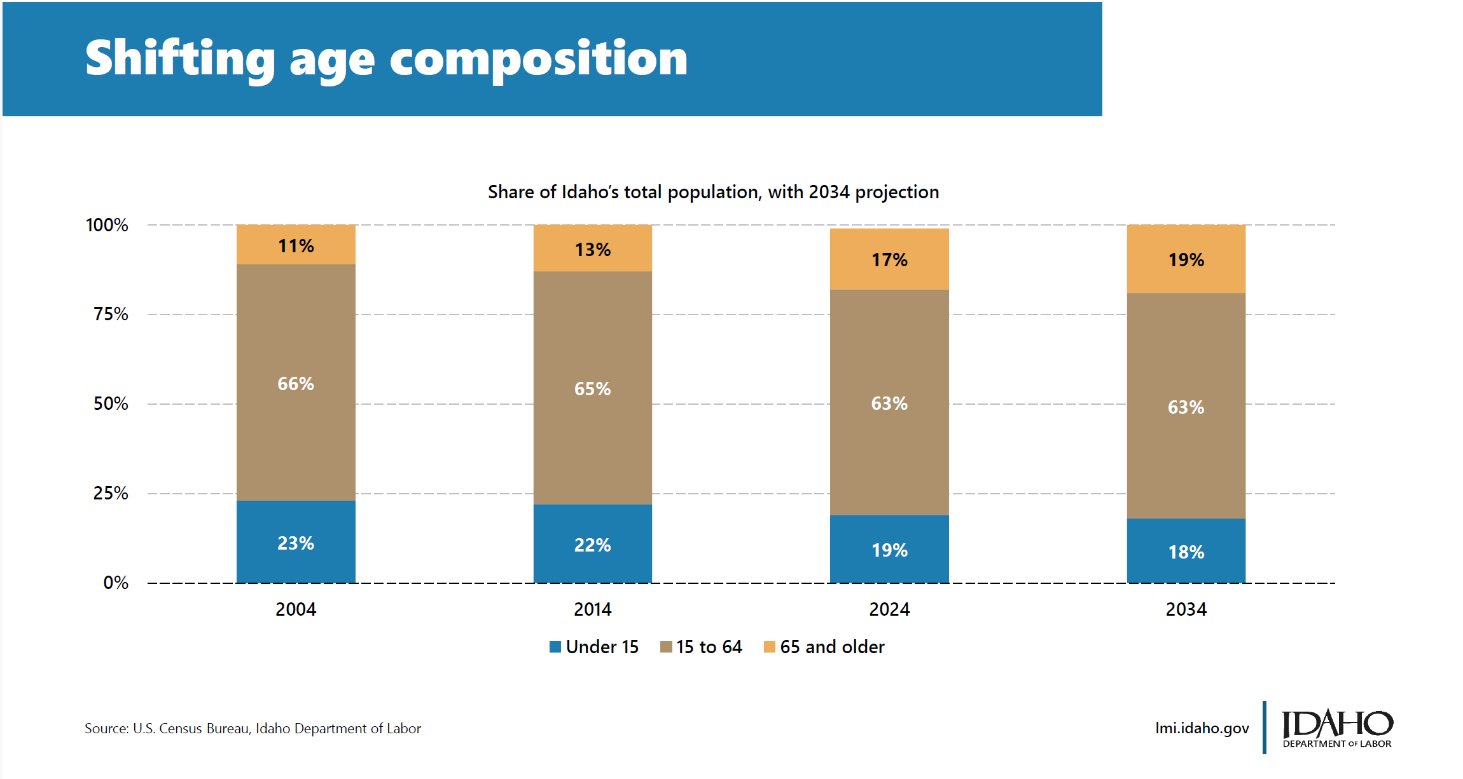
Demand Drivers

Slide 10
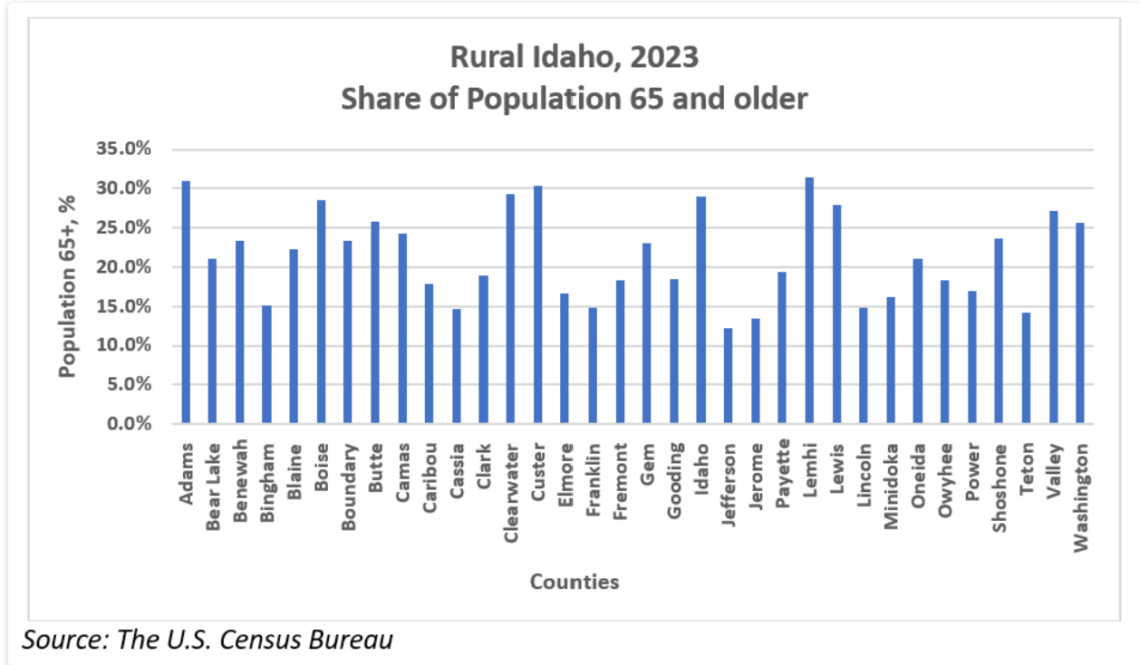
Demand Drivers

Slide 11
Demand Drivers
Aging Population:
Increased need for chronic disease management
Increase need for long-term care support services
Growth in areas such as post-acute care, rehab, and medication volume
Increase need for behavioral health and neurocognitive care
Demand for Services
Source: Centers for Disease Control and Prevention, 2025

Slide 12
Demand Drivers
Health Insurance Coverage:
Uninsured rate decreases: 18% (2008) to 9% in 2023.
Employer-provided insurance remained relatively stable.
Significant increases in Medicaid and Medicare enrollment.
Demand for Services
 | Employer | Medicaid | Medicare | Uninsured
2008 | 50.7% | 10.3% | 10.9% | 17.6%
2012 | 46.9% | 15.6% | 12.3% | 16.1%
2016 | 47.2% | 16.8% | 13.8% | 10.3%
2021 | 47.9% | 20.1% | 14.9% | 8.5%
2023 | 48.4% | 18.3% | 15.8% | 9.0%

Slide 13
Behavioral & Chronic Health Trends
Source: The Commonwealth Fund, 2025
Indicator | Idaho | US Average
Adults who are obese | 31.20% | 33.70%
Adults who report fair or poor health | 14.40% | 17.40%
Adults who smoke | 10.30% | 11.40%
Adults who went without care because of cost | 11.30% | 11.70%
Adults with age-appropriate vaccines | 30.10% | 39.30%
Adults with any mental illness reporting unmet need | 32% | 28%
Adults with substance use disorder who did not receive treatment | 74% | 77%
Alcohol deaths per 100,000 population | 17.1 | 12.6
Breast cancer deaths per 100,000 female population | 17.9 | 18.7
Hospital 30-day mortality | 15.20% | 14.40%
Infant mortality per 1,000 live births | 5.3 | 5.6
No early prenatal care | 19.10% | 23%
Patients' overall hospital experience (out of 100 points) | 71 | 67

Slide 14
Additional Demand Drivers
Economic Factors
Medical care is a normal good; as income increases, demand for medical care increases.
Advances in Medicine/Technology
Increased demand for specialized services
Changes the expectations of the patient
Extended life expectancy
Demand for Services

Slide 15
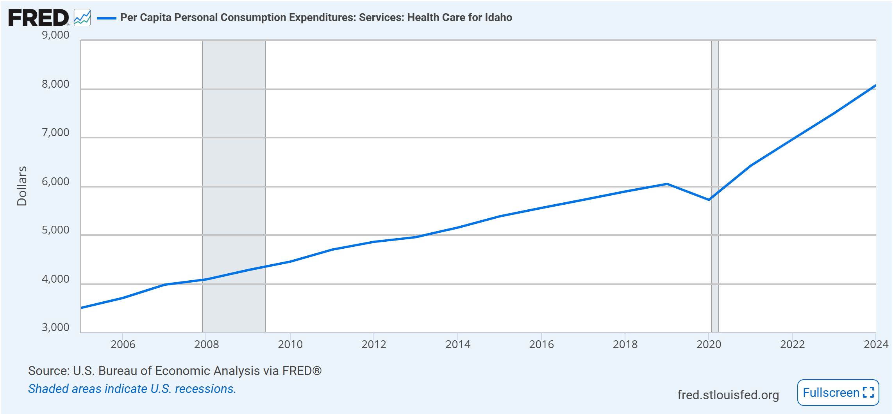
Per Capita Spending (Idaho)

Slide 16
Total healthcare expenditures
Increased from $8.8 billion to $14.5 billion between 2010-2020 (KFF, 2025)
Per capita healthcare spending
Increased 9% from 2016 to 2019
Increased 34% from 2019 to 2024
Healthcare prices
Hospital costs rose 7% in 2023 (compared to 3% for all goods and services in the US)
Per-person spending
Home health: +275% from 2000 – 2019
Prescription drug: +50% from 2018 – 2022
Hospital: +171% from 2000 – 2019
Source: Regence BlueShield of Idaho
Notes:
Prices have outpaced price growth for rest of the economy for 20 years

Slide 17
Healthcare Employment
 | 2015 | 2019 | 2022 | 2024
Healthcare Practitioners & Technical Occupations | 35,150 | 42,100 | 44,500 | 48,840
Healthcare Support Occupations | 18,130 | 32,950 | 35,850 | 36,520
All Occupations | 642,700 | 727,160 | 797,420 | 844,910
+39%
+101%
+31%
Sources: BLS Statistics (State Occupational Employment & Wage Estimates)

Slide 18
Healthcare Annual Mean Wages
 | 2015 | 2019 | 2022 | 2024
Healthcare Practitioners & Technical Occupations | $70,790 | $78,290 | $88,350 | $94,920
Healthcare Support Occupations | $27,320 | $28,680 | $32,990 | $37,760
All Occupations | $40,810 | $44,890 | $51,350 | $58,440
+34%
+38%
+43%
Sources: BLS Statistics (State Occupational Employment & Wage Estimates)

Slide 19
Total Spent (Average Wages * Number of Workers): Overall
$26.2 billion to $49.38 billion
88% growth (2015 – 2024)
Healthcare Support Occupations
Healthcare Practitioners & Technical Occupations
$2.48 billion to $4.64 billion
87% growth (2015 – 2024)
$495 million to $1.38 billion
179% growth (2015 – 2024)

Slide 20
Shortage Areas (SAs)
Sources: KFF Primary Care Health Professionals Shortage Area; Centers for Disease Control & Prevention
Primary Care Professionals SA
Percent of need met 42.53% (2024); 99 practitioners needed to remove shortage
Dental Care Professionals SA
Mental Health Care Professionals SA
Percent of need met 27.2% (2023); 48 practitioners needed to remove shortage
Percent of need met 48.65% (2024); 60 practitioners needed to remove shortage
OBGYN
Seen a 35% reduction in physicians practicing obstetrics (JAMA, 2025)

Slide 21
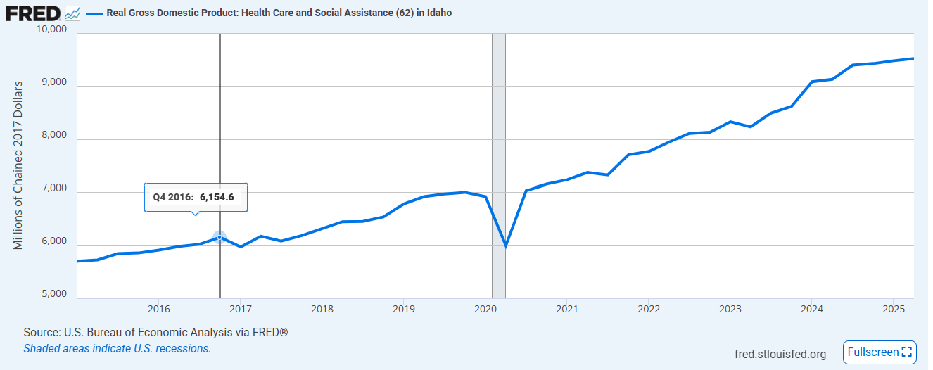
Growth between 2016 – 2024: +53%

Slide 22
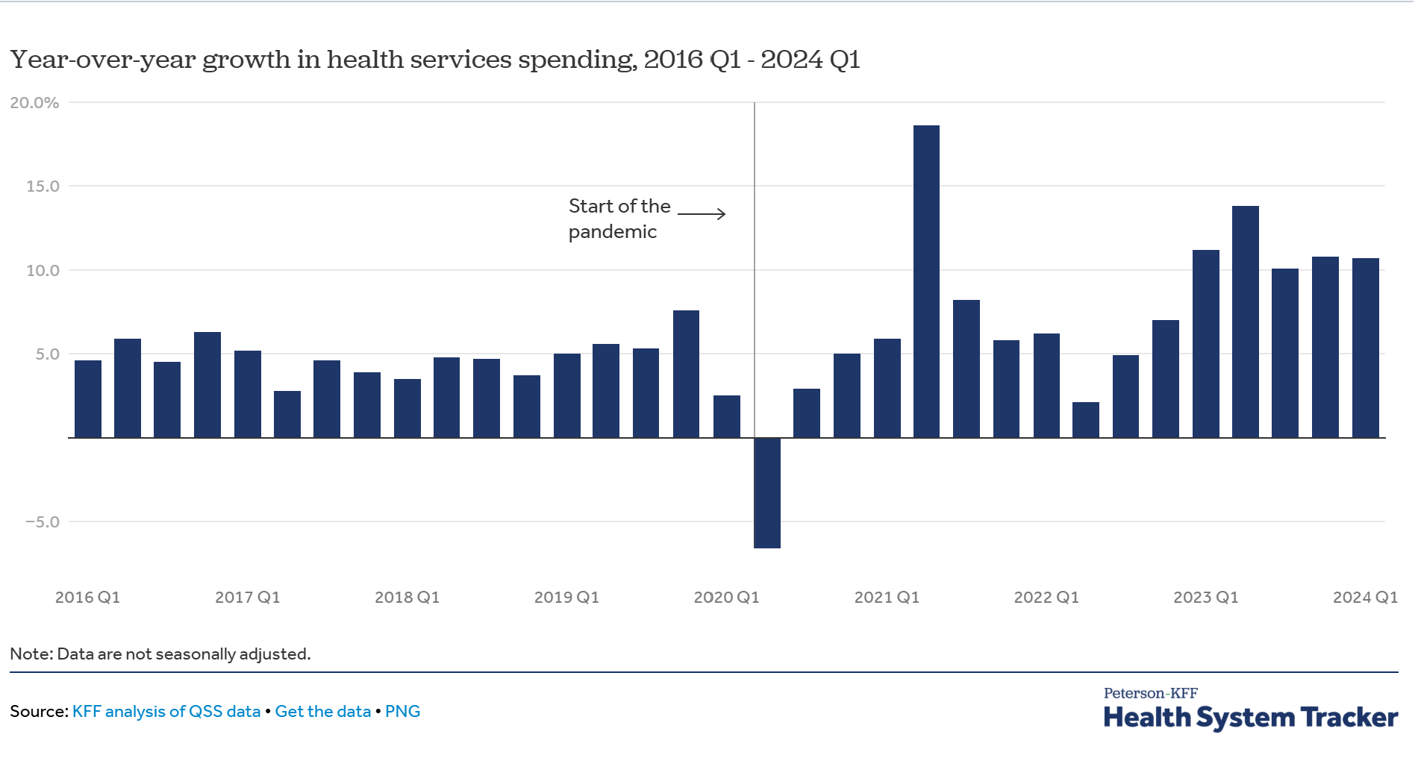
Rising cost pressures, affordability, and utilization
Source: KFF analysis of QSS data

Slide 23
Rising cost pressures, affordability, and utilization
Hospital spending growth now outpaces pre-pandemic rates
Nursing/residential care spending up 10–13% annually since 2023
Hospital discharges remain below pre-pandemic levels
Inpatient admissions declining per capita over time and outpatient visits trending upward
ER and doctor visit rates back to pre-pandemic levels
Source: KFF analysis of QSS data

Slide 24
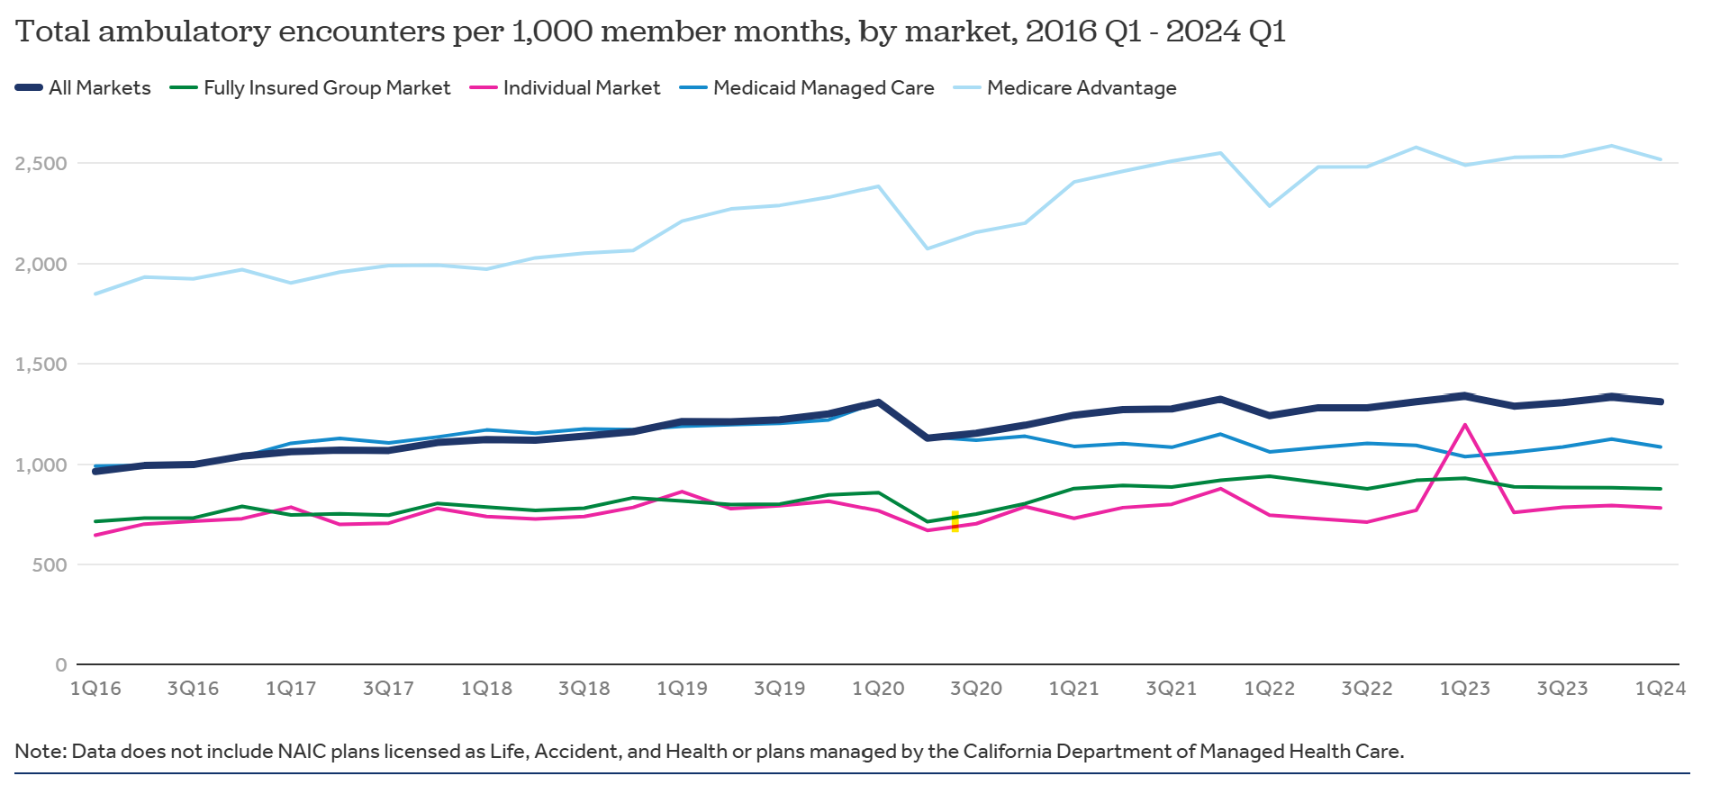
Rising cost pressures, affordability, and utilization
Source: KFF analysis of QSS data

Slide 25
Areas of Concern
Regulatory burdens
Changes in cost structures & reimbursement rates
Drug-price negotiations, transparency rules, and mental health parity
If costs continue to climb and consumers struggle with affordability →
Worse health outcomes, higher uncompensated care, and pressure on public programs (Medicare/Medicaid)
Source: McKinsey & Company, 2025

Slide 26
Hospital Payments & Margins
$130 billion in hospital underpayments from Medicare & Medicaid (2023)
Medicare reimburses only 83¢ per $1 spent on patient care
Inflation (2022–2024): +14.1% vs. Medicare rate increase: +5.1% → effective payment cut
Medicare Advantage plans adding pressure through delays, denials, & lower reimbursements
Rising costs ahead: 70% of U.S. medical devices are imported; tariffs expected to raise hospital expenses
Source: American Hospital Association, 2025

Slide 27
Areas of Concern
Workforce shortages, burnout, and aging workforce
Chronic disease management & aging population
Access & equity
Geographic, socioeconomic, and insurance-based disparities remain challenging.
Patients increasingly delay or avoid care because of cost of access issues.
Cybersecurity & infrastructure
Healthcare sector had the highest number of cyberthreats in 2023
Healthcare policy environment
Source: McKinsey & Company, 2025

Slide 28
Changes in Healthcare Policy
Medicaid reimbursement cuts in Idaho
IDHW enacted a 4% reduction across most provider types and services
Category | Before Cut | After 4% Cut | Difference
Average per enrollee | $8,014 | $7,693 | −$321
Total Medicaid spending | $3.09 billion | $2.96 billion | −$130 million

Slide 29
Changes in Healthcare Policy
Impacts:
Many rural hospitals operate on <2% margins.
Risk of service cuts in obstetrics, behavioral health, and emergency care.
Reduced access: longer wait times, service closures, or longer travel for care.
Cost shifting: higher commercial rates and out-of-pocket costs for privately insured patients.

Slide 30
Projections of OBBBA on Idaho
Overall Fiscal & Coverage Impact
Federal health cuts: $1.1 trillion over next 10 years
Decrease Medicaid funding in Idaho by 9% over next 10 years
Medicaid Changes
Estimated 40,000 Idahoans will lose Medicaid coverage by 2034
Marketplace Changes
Estimated 35,000 Idahoans will lose marketplace health insurance by 2034
Source: Idaho Supports Medicaid Fact Sheet (2025)

Slide 31
Economic Projections: Medicaid (OBBBA)
Decrease in Health Spending
Medicaid benefit spending (Idaho): $8,014 in FY2023
Decrease in Federal Money
Federal match (90%): $216 to $289 million of decrease in spending is federal dollars
Conversative estimate: $24 million/year; $240 million over 10 years
Idaho average-cost case estimates:
Assuming 4,000 individuals/year: $32 million/year
Over the total 10 years: 321 million
Source: USAFacts, 2025

Slide 32
Economic Projections (OBBBA)
Multiplier Effects
Healthcare has sizable local ripple effects
Idaho Hospital Association: physician/health-sector multiplier is around 1.3 – 1.7; using a range from 1.4 – 1.6 →
From $321M direct → $449M to $514M total output loss
From $240M direct → $336M to $384M total output loss.

Slide 33
Economic Projections (OBBBA)
Other Impacts
Increase in the use of uncompensated care → pressuring hospital margins (especially in rural facilities)
Access and local jobs risks
Premium and cost-shift pressure
Spillover to small business and lenders

Slide 34
Key Takeaways
A story of supply and demand imbalance…
Idaho’s aging and rural demographics are driving demand.
Physician, nursing shortages, and work shortages remain an operational risk.
Cost and reimbursement pressures threaten hospital margins statewide.
Notes:
Federal policy changes (OBBBA) will cut Medicaid funding and enrollment by 2034.

Slide 35
Questions?
Email: irisbuder@isu.edu

