Slide 1
January 23, 2026
Jason K Hansen, PhD
Distinguished Research Economist
Catalyzing Market Transitions:
Innovation, Investment, and the Energy Future
INL/MIS-26-89784

Slide 2
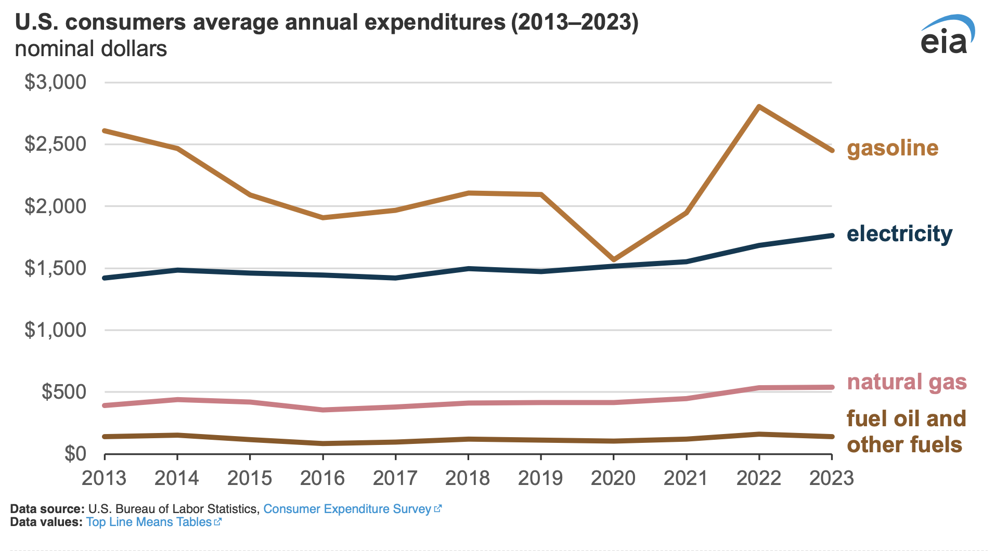
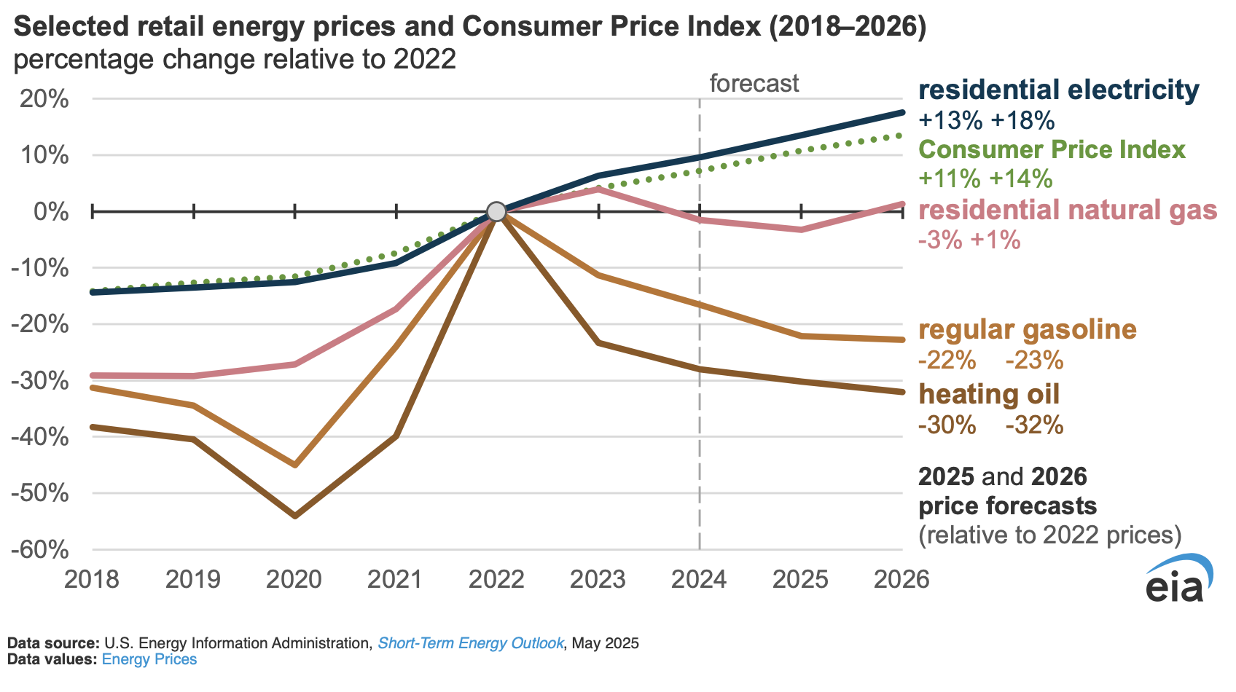
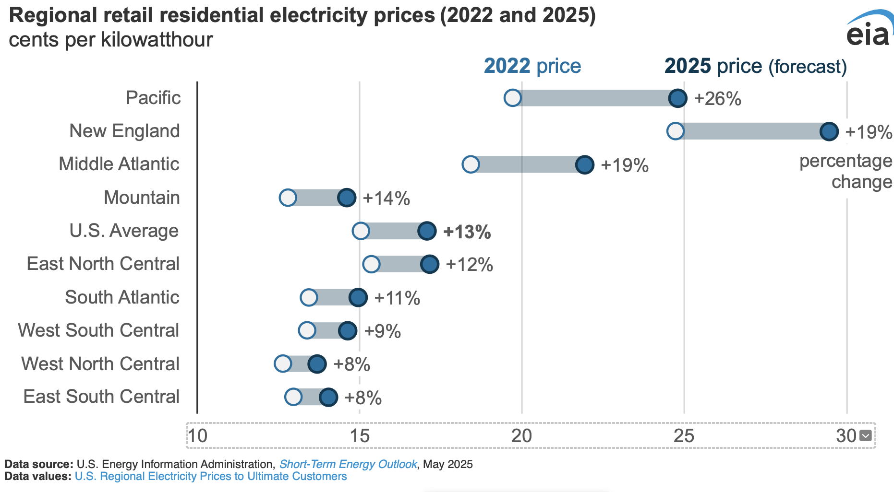
Affordability, Energy Prices, and Energy Outlook
Discussion of affordability have moved from kitchen-table economics to the national and global stage of political economy.
Energy is in the heart of these discussions.
Households have seen relief in gasoline prices but not in electricity prices.
Notes:
Affordability has taken center stage – energy prices are central to that
1990 – 2024 very little new load growth
Electrification homes and business, re-shoring manufacturing, data centers
Energy infrastrufgutre in US reaching end of its useful life, “D”
Decline in prices due to fracking, natural gas
TX, CA, Europe blackouts
Global lng markets,
1 in 6 households struggle to pay existing energy bills

Slide 3


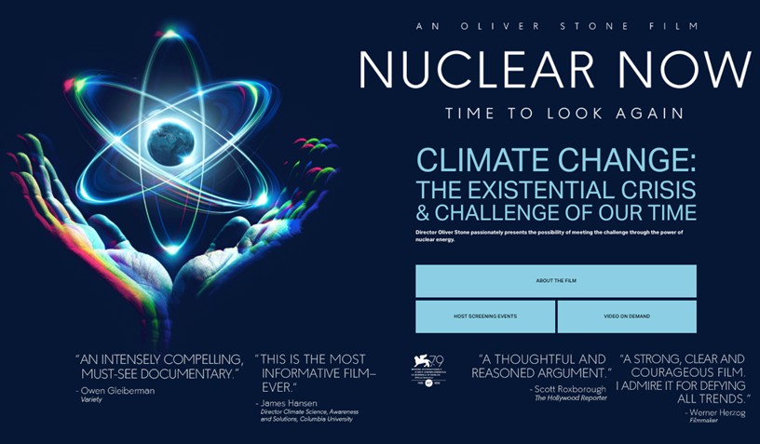
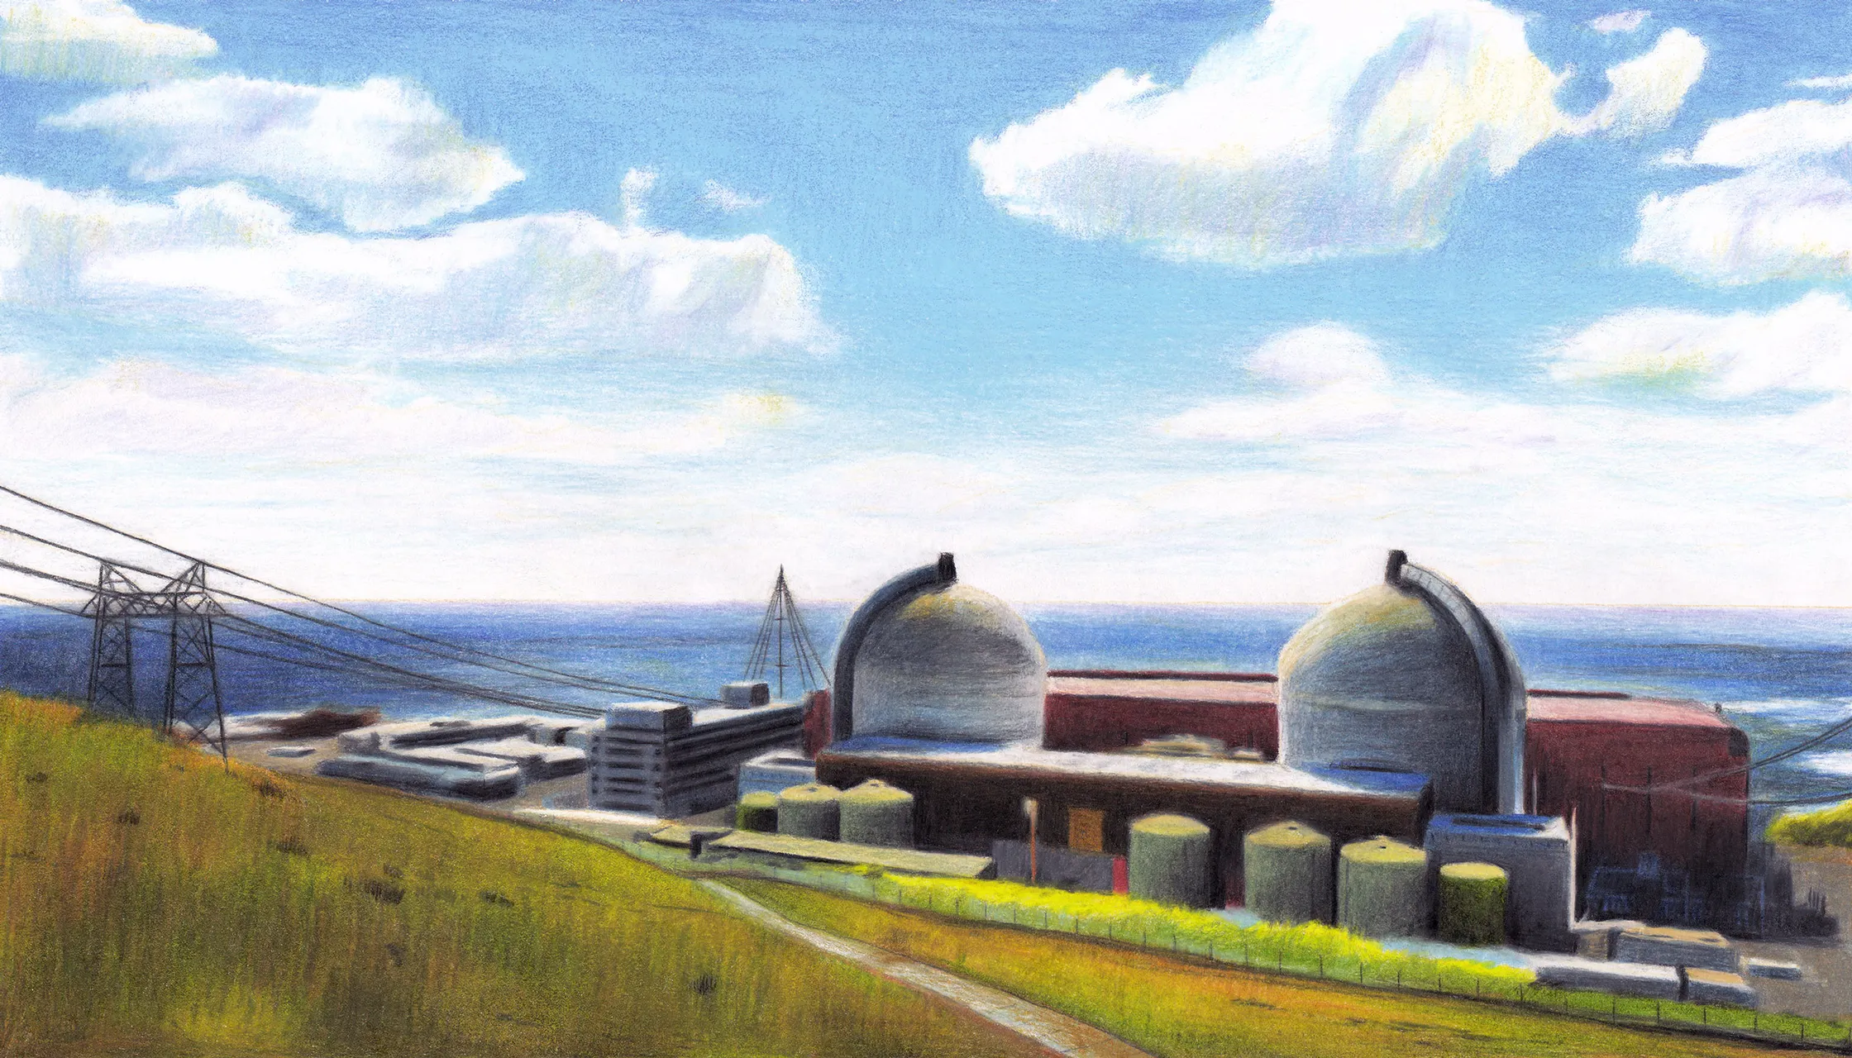
Growing Public Support for Nuclear Technology

Slide 4


Unleashing the golden era of American energy dominance
Advance energy addition, not subtraction
Unleash American energy innovation
Return to regular order on LNG exports
Promote affordability and consumer choice
in home appliances
Refill the strategic petroleum reserve (SPR)
Modernize America’s nuclear stockpile
Unleash commercial nuclear power
in the United States
Strengthen grid reliability and security
Streamline permitting and identify undue
burdens on American energy
“The long-awaited American nuclear renaissance
must launch during President Trump’s administration. As global energy demand continues to grow, America must lead the commercialization of affordable and abundant nuclear energy.”
Secretary of Energy, Chris Wright

Slide 5
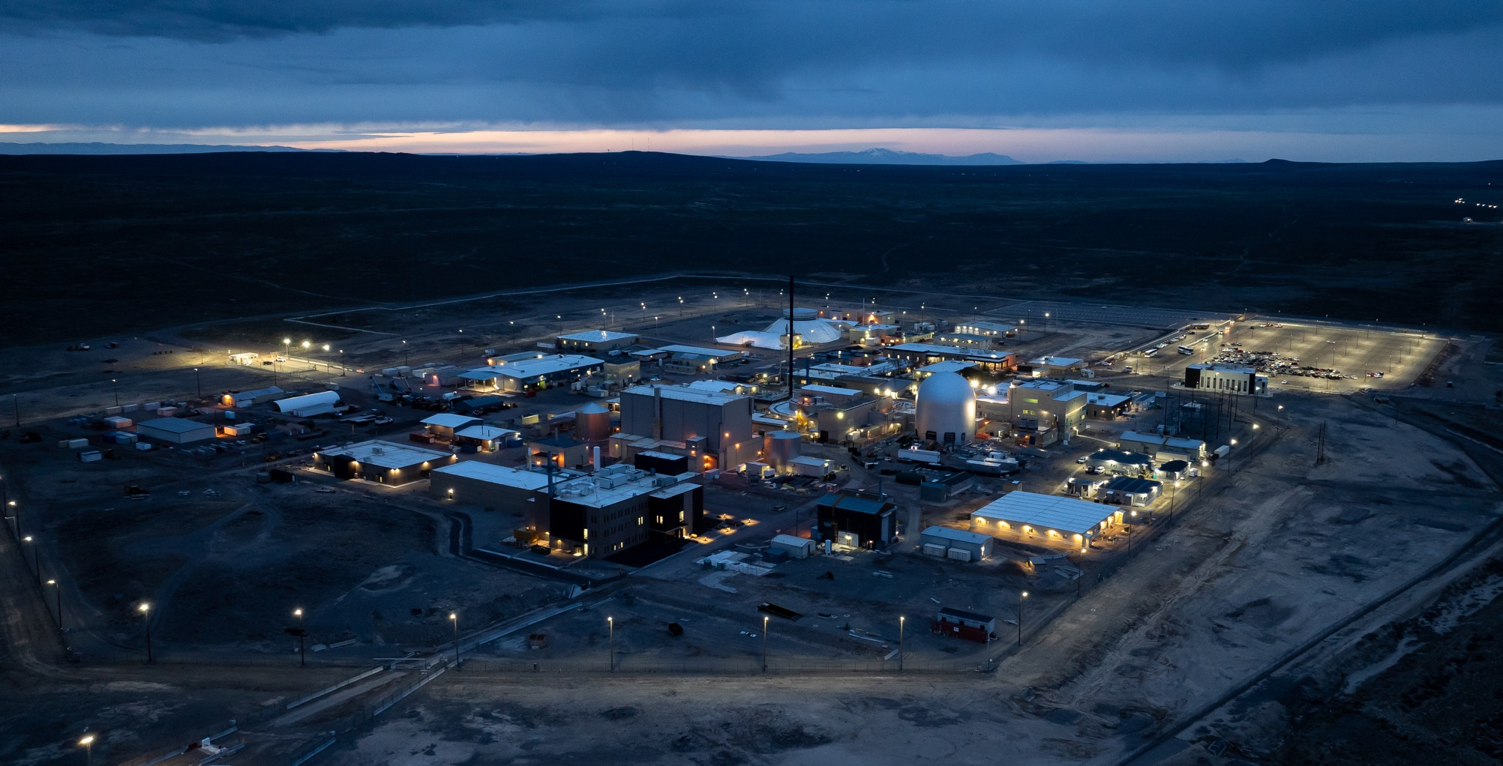
The path to
energy security runs through Idaho. It’s our responsibility to make it a reality.
Notes:
Idaho is at the center of a once-in-a-generation energy investment cycle—but only if markets, technology, and policy align fast enough

Slide 6
Catalyzing Market Transitions
Unpack the drivers of energy demand and supply to look at price pressure.
Look at the economic developments that are generating steam with the technology in the nuclear industrial complex.

Slide 7
Energy Demand

Slide 8
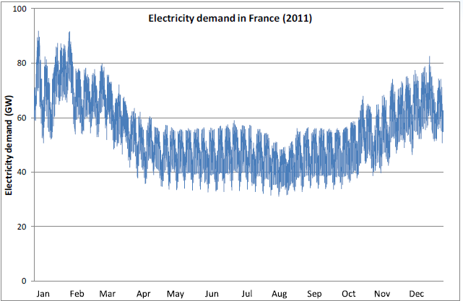
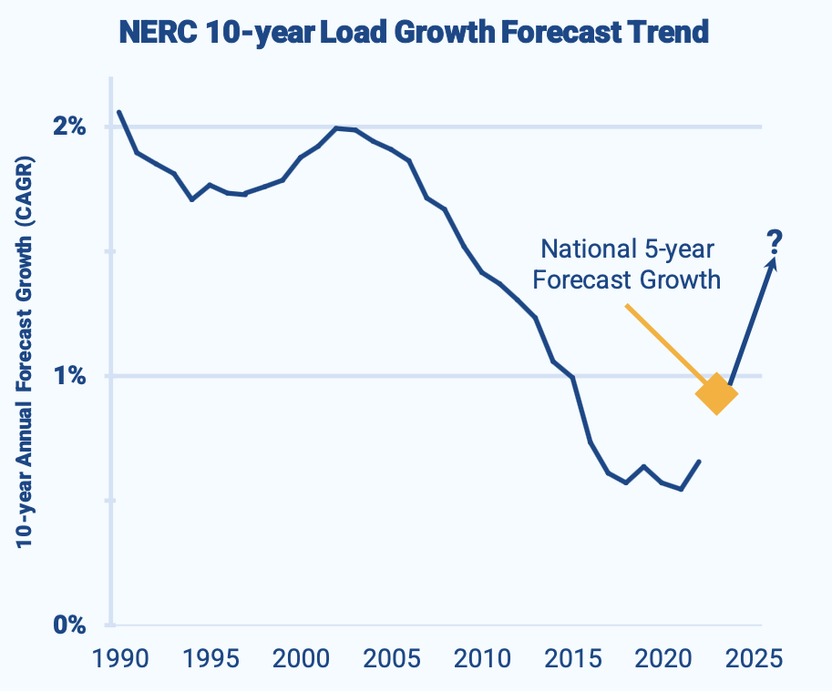
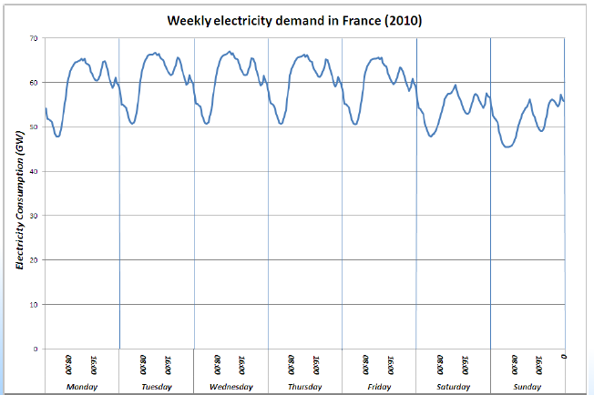
Forecasting growth in energy demand . . .
Predictable Variability
s
GridStrategies here, here and here

Slide 9
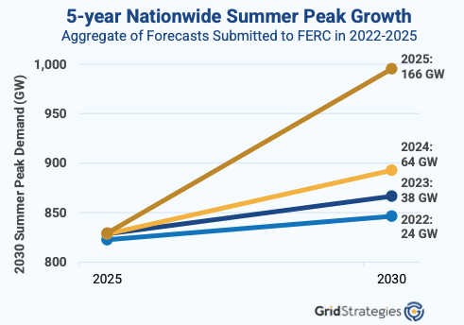
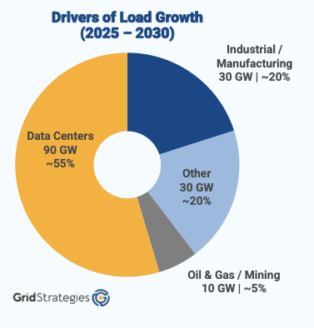
. . . is complicated . . .
. . . because of changing industry dynamics.
Electrification, re-shoring manufacturing, and data centers are scaling up energy intensity.
Substantial
Increase!
GridStrategies here, here and here
Notes:
Electrification homes and business, re-shoring manufacturing, data centers

Slide 10
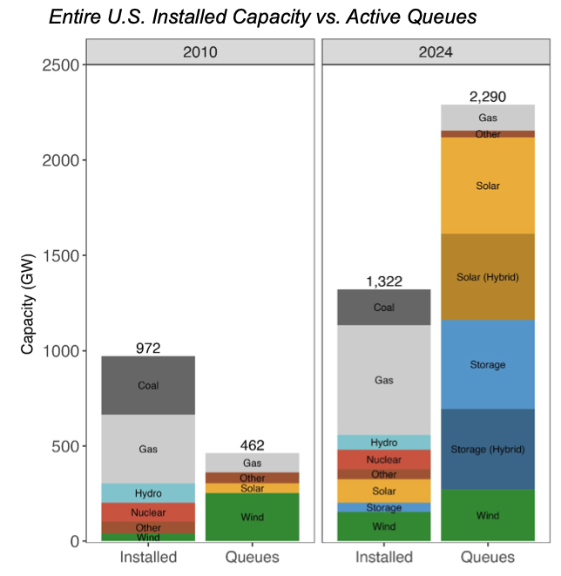
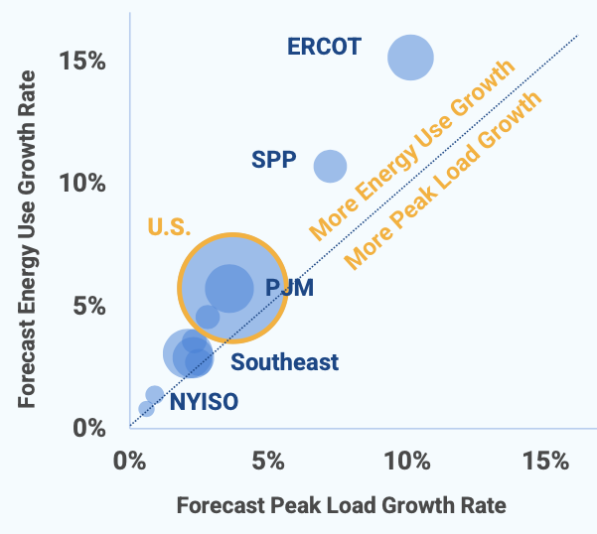
. . . is complicated . . .
. . . because it takes time to build generating capacity and get it onto the grid.
Energy use is growing faster than peak load and the waiting line is larger than the grid itself.
GridStrategies here, here and here
LBNL here

Slide 11
Energy Supply

Slide 12
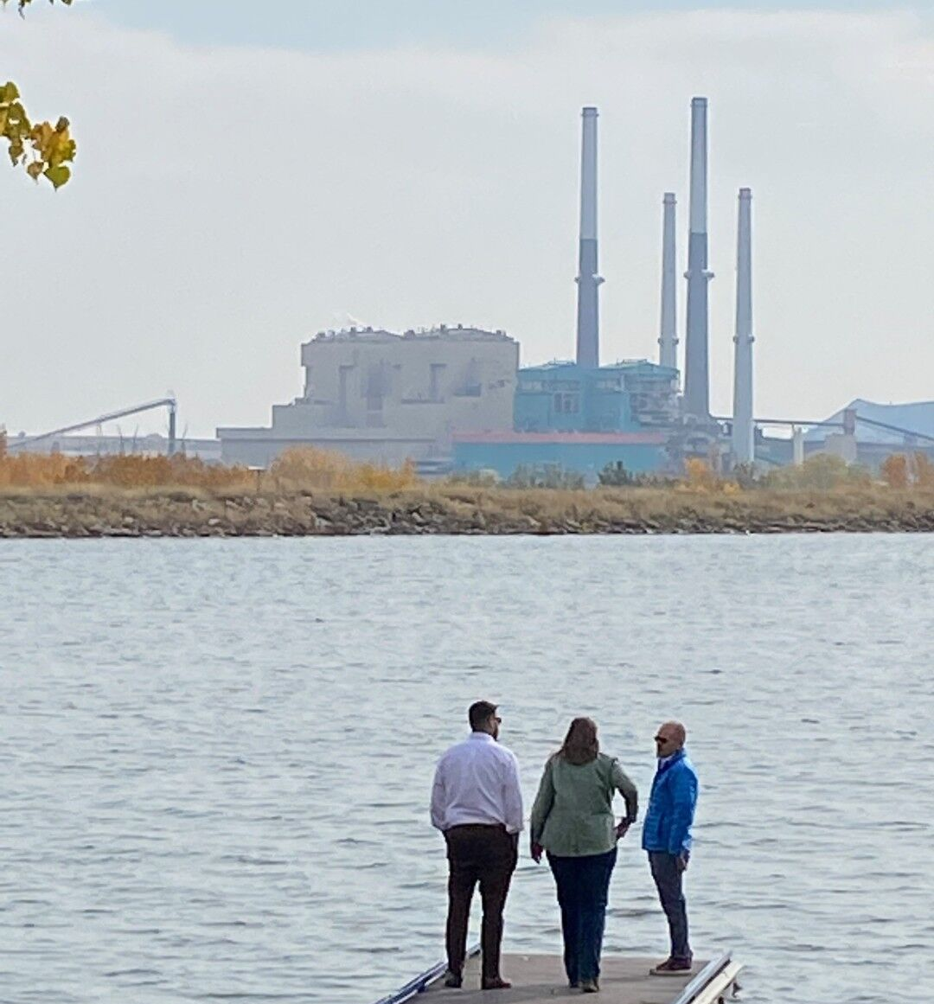
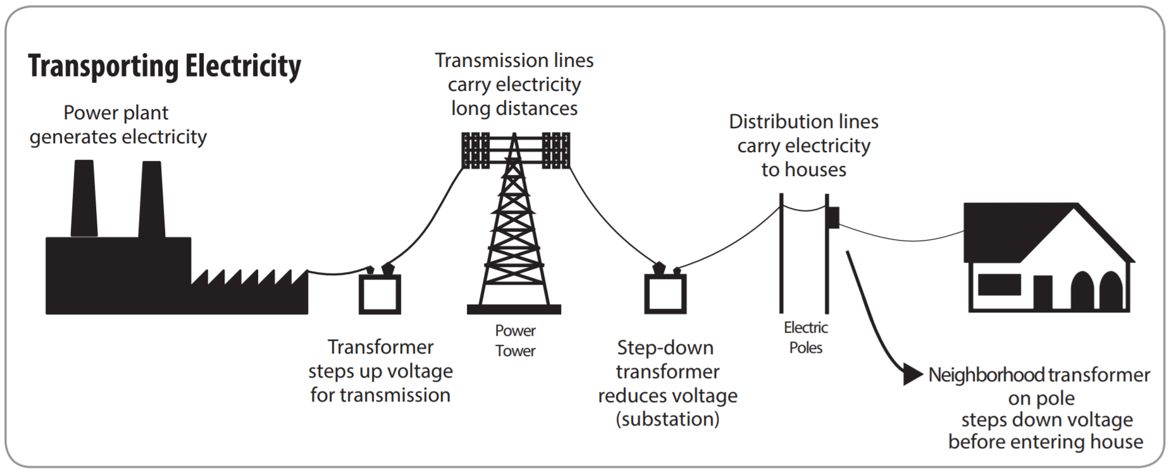


The Electricity System and Energy Choices
Energy Mix
Emissions/waste
Technical Interface
Energy Demand
Where to begin?
. . . have costs, benefits, and financial risks that affect on-time and on-budget objectives.
. . . also have many stakeholders, each with incentives and input into energy outcomes. Can they *incentives* all be aligned?
Notes:
How much will it cost?
Is it financially risky? How risky?
When will it be ready?
Which reactor offers the best value?
Economic viability means that diverse attributes of nuclear technology fit together in a systematic way to create value.
Economic efficiency (i.e., best use of resources) means that the benefits/value of technology are proportional to the costs.
Every energy debate collapses to economics once reliability is non-negotiable

Slide 13




Generation Asset Cost Structure
Fossil Fuel Power Plants
LOW Fixed Costs
HIGH Variable Costs
Nuclear Power Plants
HIGH Fixed Costs
LOW Variable Costs
Renewables
LOW Fixed Costs
LOW Variable Costs
Variable costs consist mainly of fuel costs
Small amounts of fuel generate large amounts of power
Requires many employees to operate
No fuel costs
Plants can operate without many employees

Slide 14
Intersection of Costs and Market Structure
Liberalized Market, (FC dominant)
Liberalized Market, (VC dominant)
Regulated Utility, (FC dominant)
$/Q
D
$/Q
P₁
Break-even
MC
Profits
AC
P₂
AC₁
Profits
P₂
AC
Losses
(fixed costs, missing money)
AC₂
D
MC
Q₁
Q₂
Q3
Q
Q₂
MR
MR
14
(Viscusi 2005)

Slide 15
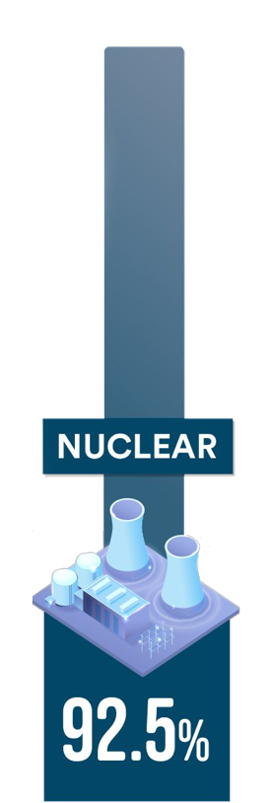
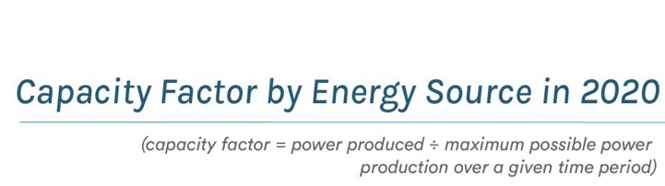
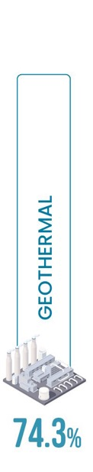
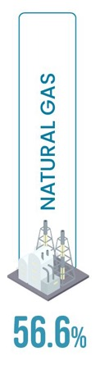
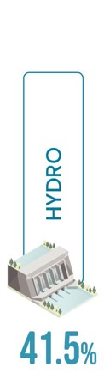
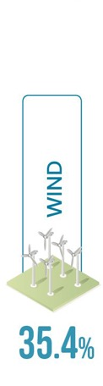
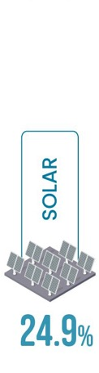
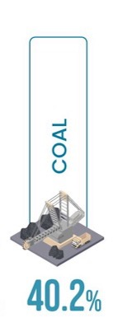
Nuclear technology provides flexible, reliable, high-density energy with comparatively low land use
RELATIVE LAND FOOTPRINTS
Biomass
Hydro
Wind
(onshore)
Solar (PV)
Coal
Natural Gas
Nuclear
Data source: U.S. Energy Information Administration
Source: World Nuclear Association
Notes:
https://www.bloomberg.com/graphics/2021-energy-land-
https://ourworldindata.org/land-use-per-energy-sourceuse-economy/?leadSource=uverify%20wall
https://www.bloomberg.com/graphics/2021-energy-land-use-economy/?leadSource=uverify%20wall
https://world-nuclear.org/information-library/energy-and-the-environment/nuclear-energy-and-sustainable-development.aspx

Slide 16
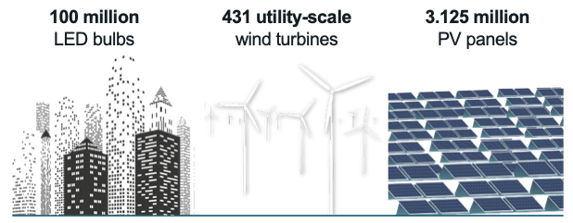
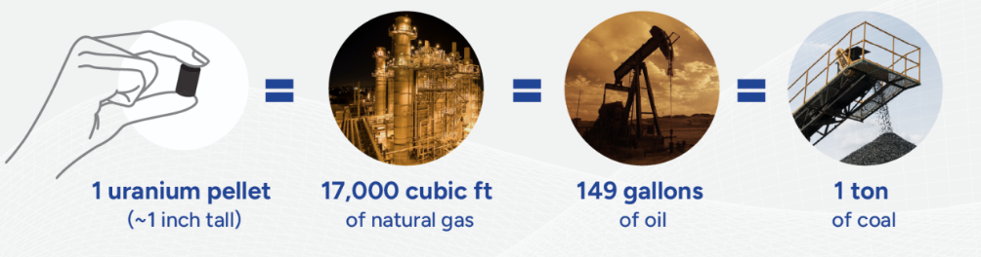
Energy Density
How much power does a
nuclear reactor produce? (1 GW)
Boiling water (generating steam) can be done in many ways. Given a fixed level of power output, how much fuel does it take?
Uranium is a power-packed fuel.
(DOE NE here and here)
(CNA here)

Slide 17
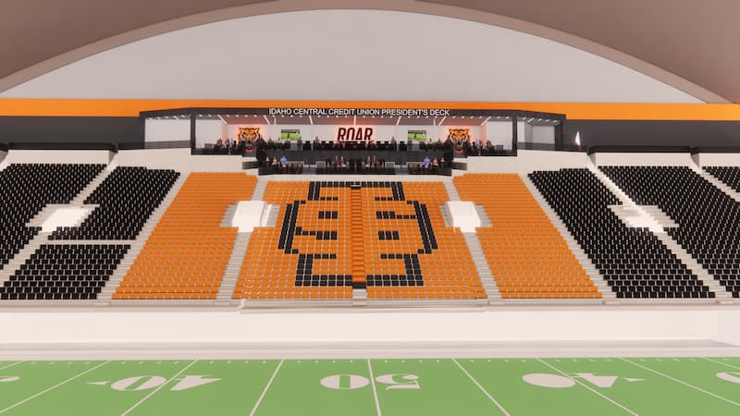
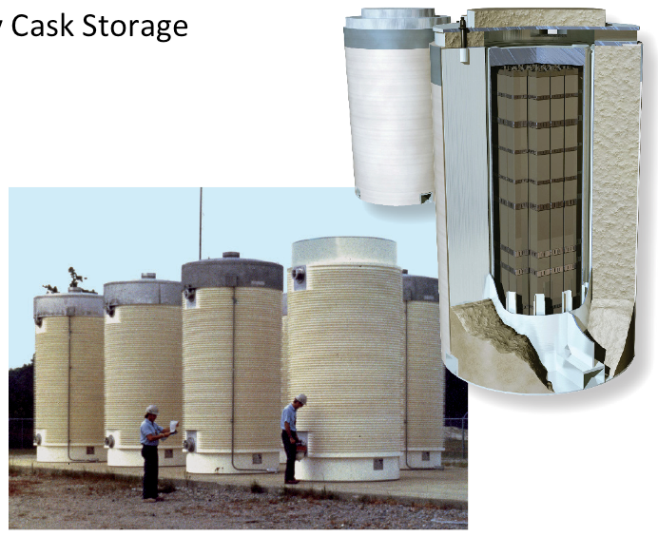

Waste Management
Spent fuel is solid and stored in casks
U.S. has produced about 90k metric tons, about the size of a football field at 10 yards deep.
Spent fuel stored at 70 sites in 35 states
Spent fuel can be recycled – more than 90% of potential energy remains in the fuel.
Energy density means
waste density

Slide 18
Nuclear Industrial Complex

Slide 19
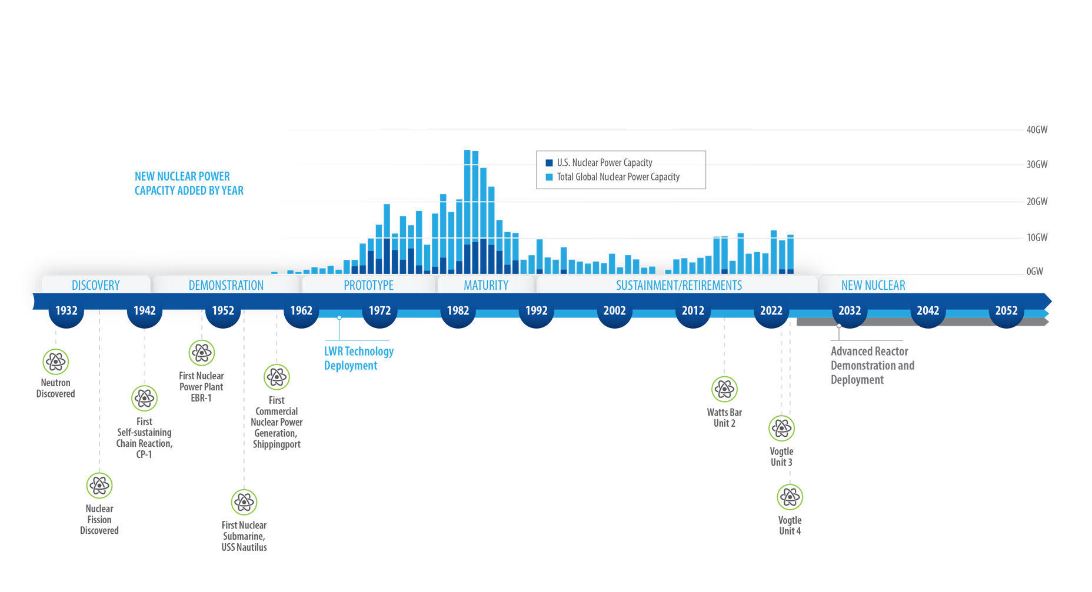
Economic prosperity and global competitiveness demand a dramatic, rapid expansion of nuclear
Notes:
23-50477-R14b_Nuclear_History_Timeline*
Source: https://www.spglobal.com/marketintelligence/en/news-insights/latest-news-headlines/new-build-nuclear-must-face-down-industry-s-costly-past-72854285

Slide 20
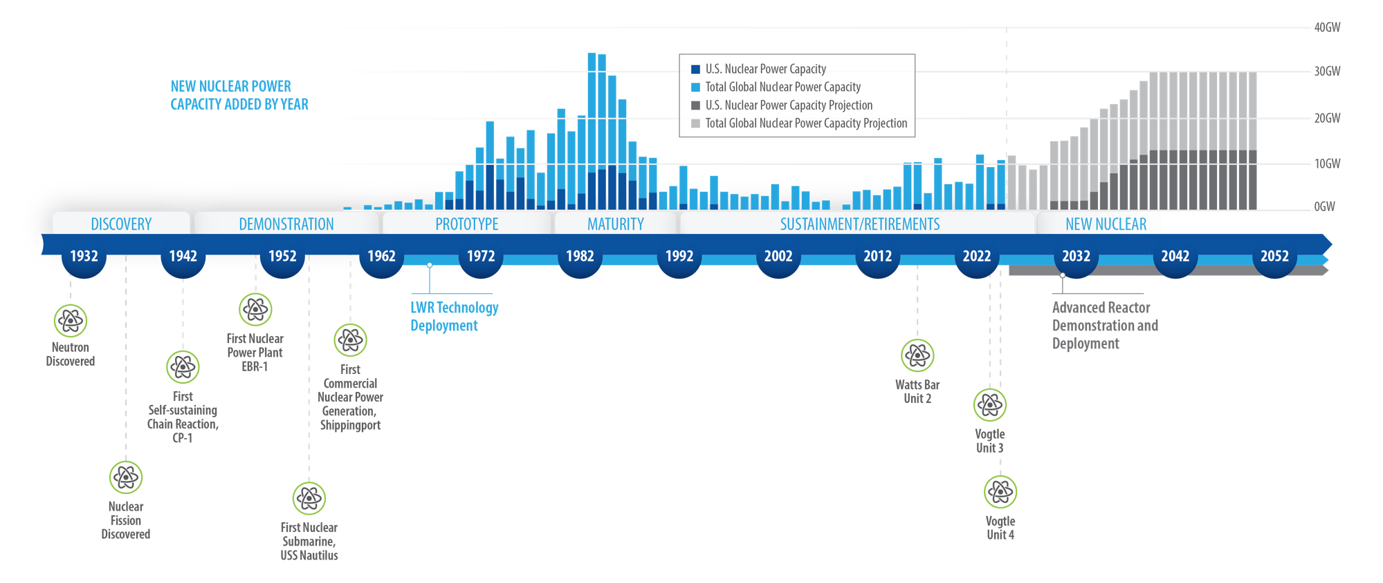
Technical innovation and strategic partnerships will overcome technical, geopolitical, policy, and economic challenges to deployment
Notes:
23-50477-R15a_Nuclear_History_Timeline*
Source: https://www.spglobal.com/marketintelligence/en/news-insights/latest-news-headlines/new-build-nuclear-must-face-down-industry-s-costly-past-72854285
All global capacity including US) additions 1960- present plus projection to 2050: https://www.spglobal.com/marketintelligence/en/news-insights/latest-news-headlines/new-build-nuclear-must-face-down-industry-s-costly-past-72854285
U.S capacity: 1970-2023: https://www.eia.gov/todayinenergy/detail.php?id=57280
US capacity prior to 1960: https://www.eia.gov/todayinenergy/detail.php?id=30972
US projected capacity: https://liftoff.energy.gov/advanced-nuclear/
https://www.iaea.org/newscenter/pressreleases/iaea-outlook-for-nuclear-power-increases-for-fourth-straight-year-adding-to-global-momentum-for-nuclear-expansion
“at the end of 2023, 413 nuclear power reactors were operational, with a global capacity of 371.5 GW(e). In the high case scenario of the new IAEA outlook, nuclear electrical generating capacity is projected to increase to 950 gigawatts by 2050. In this case, global capacity in 2050 would be slightly more than 2.5 times what it was in 2023. In the low case projection, capacity rises 40 per cent to 514 gigawatts. Small modular reactors, or SMRs, account for about one quarter of the capacity added in the high case and for 6 per cent in the low case scenario.”

Slide 21
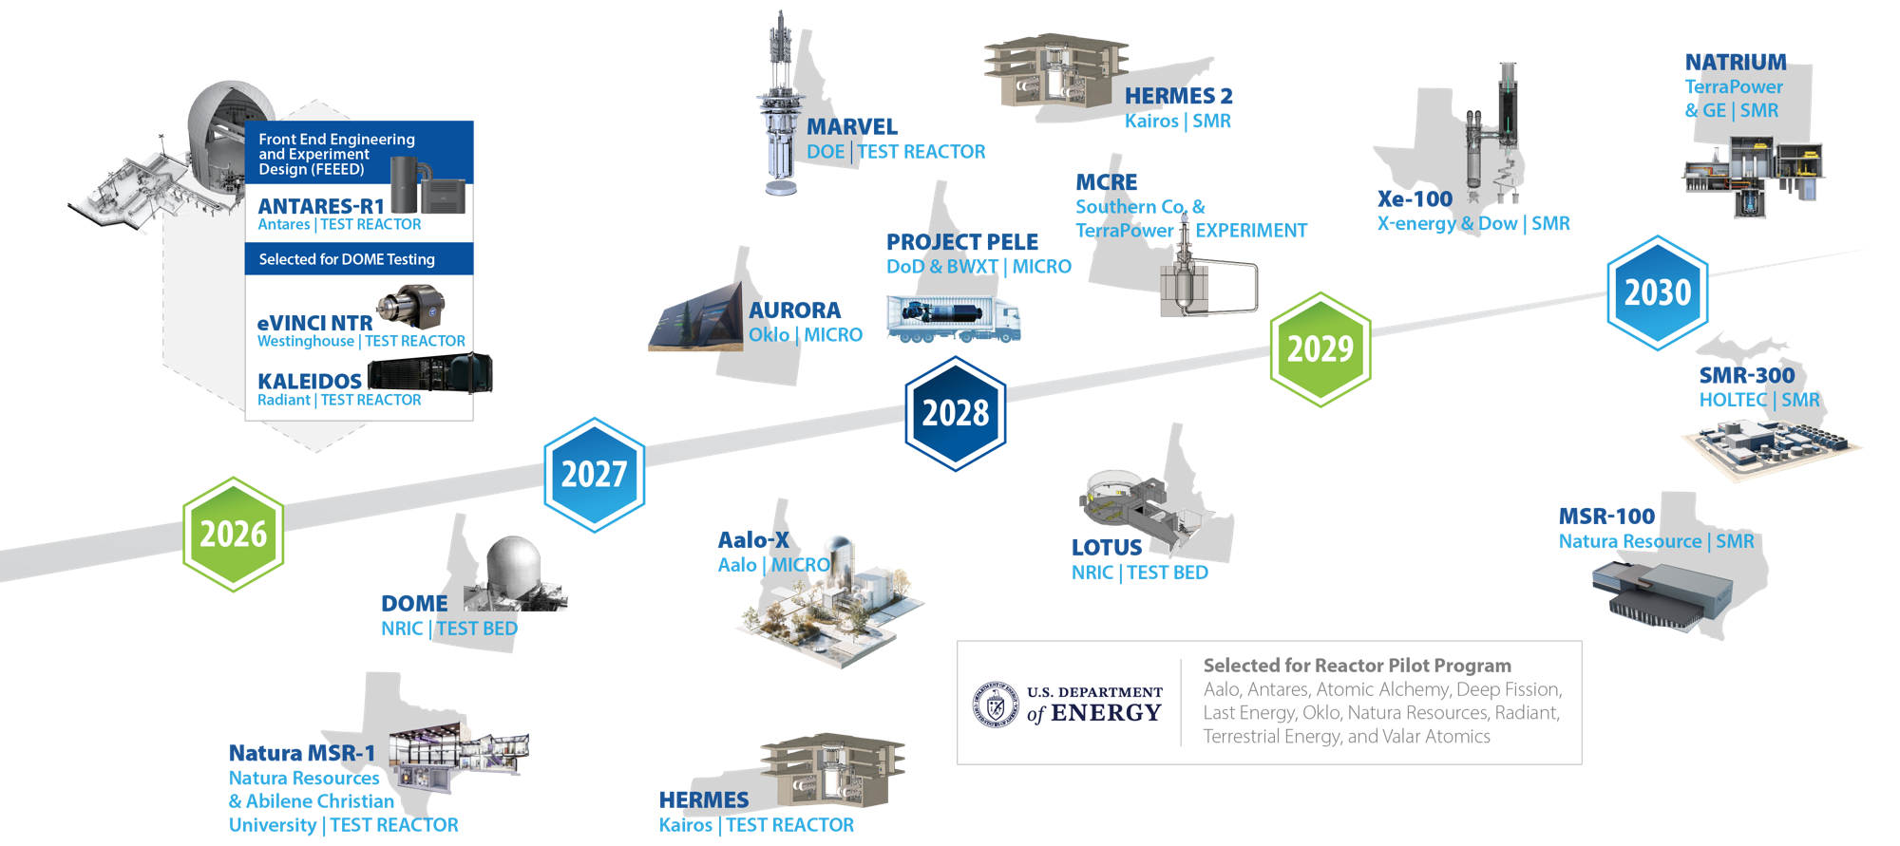
Accelerating advanced reactor demonstration and deployment

Slide 22
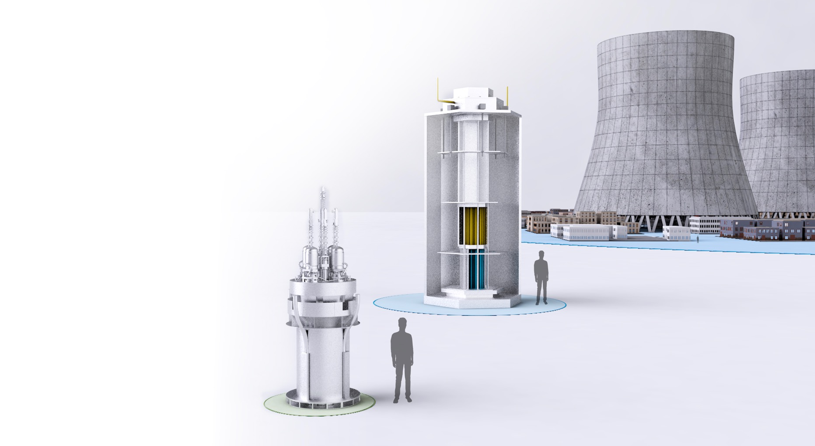
Advanced reactor size comparison
Large-Scale Reactor
300 MW – 1,000+ MW
1,500 ACRES
Small Modular Reactor
20 MW – 300 MW
50 ACRES
Microreactor
1 MW – 20 MW
LESS THAN AN ACRE

Slide 23
Cost Behavior
How much does nuclear power cost?
Average Cost Curve
$/MWe
SMRs
“FOAK*”
6250
Large
Reactors
“NOAK**”
SMRs
5000
2750
300
1000
MWe
*First-of-a-Kind
**N^{th}-of-a-Kind
(Dixon 2017 here; Abou-Jaoude 2024 here)
*First-of-a-Kind
Notes:
Reduce operating costs
Automate operations with AI and ML
Enhance advanced nuclear power plant design, licensing, and deployment life cycle through AI and digital engineering
Increase safety and
enhance performance of
nuclear fuels and materials
Enable LWR fuel burnup
extension through new
capability development

Slide 24
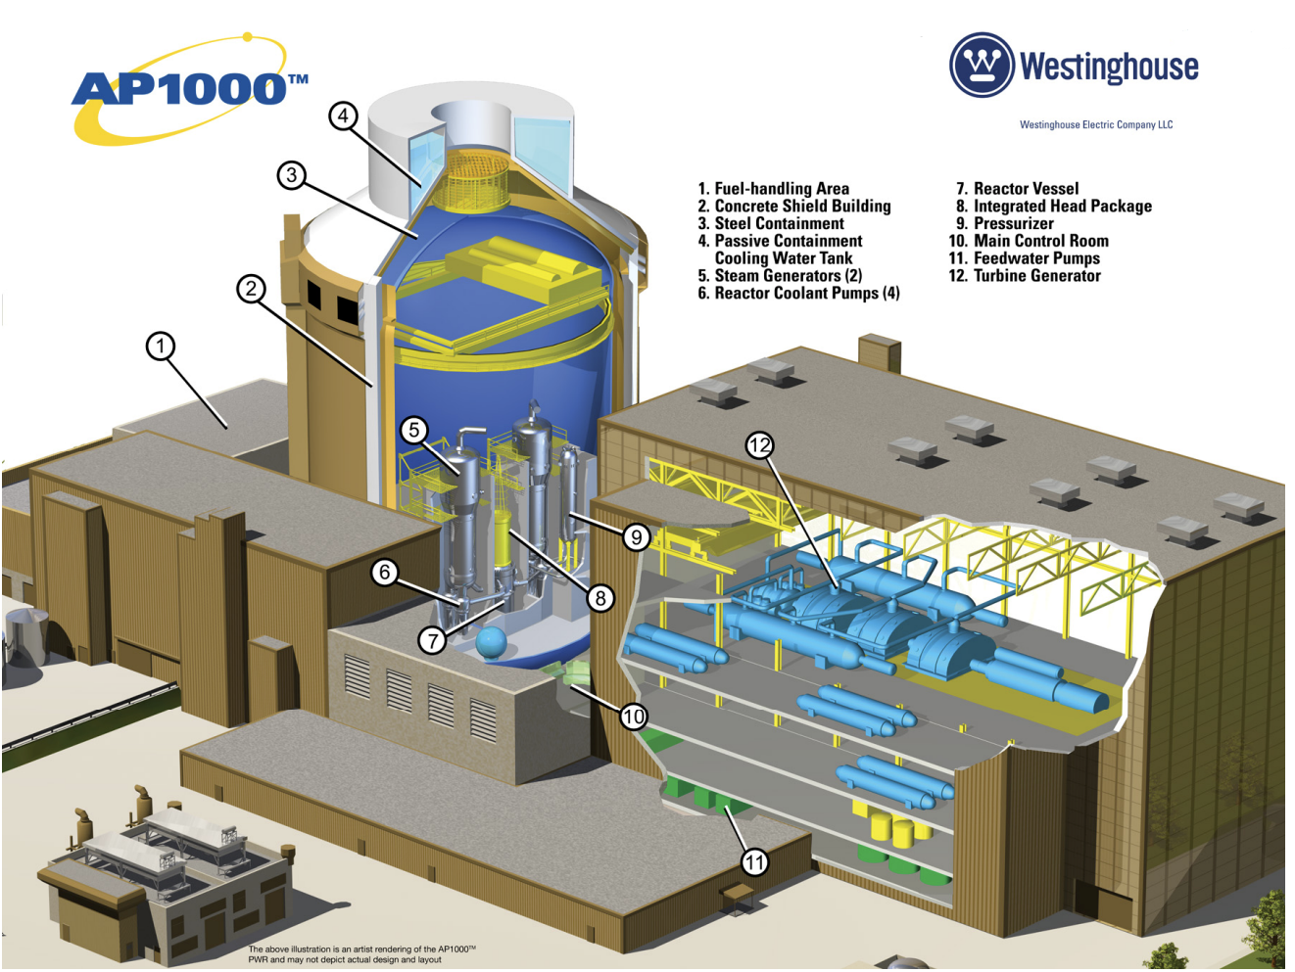
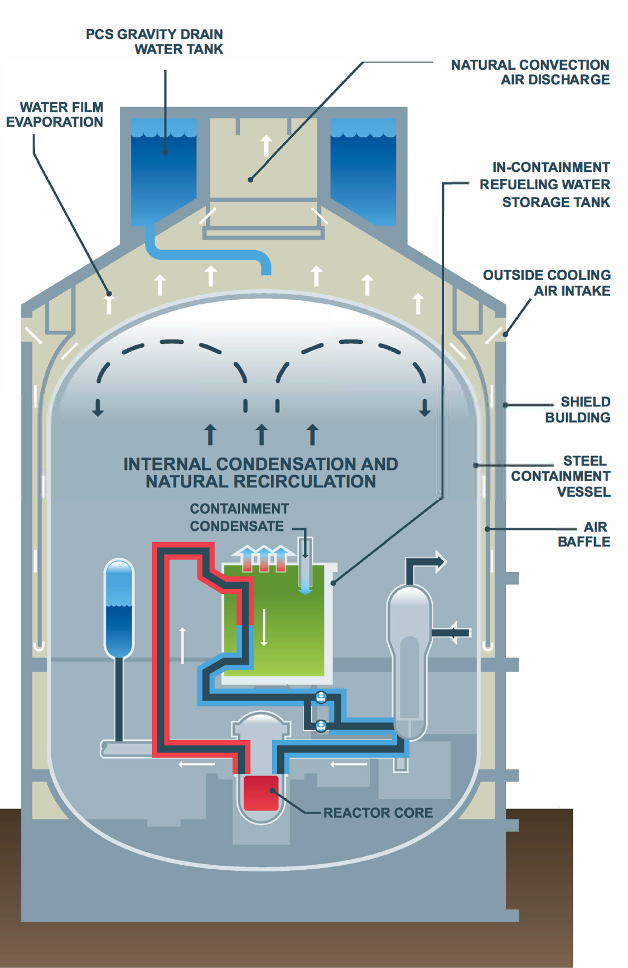
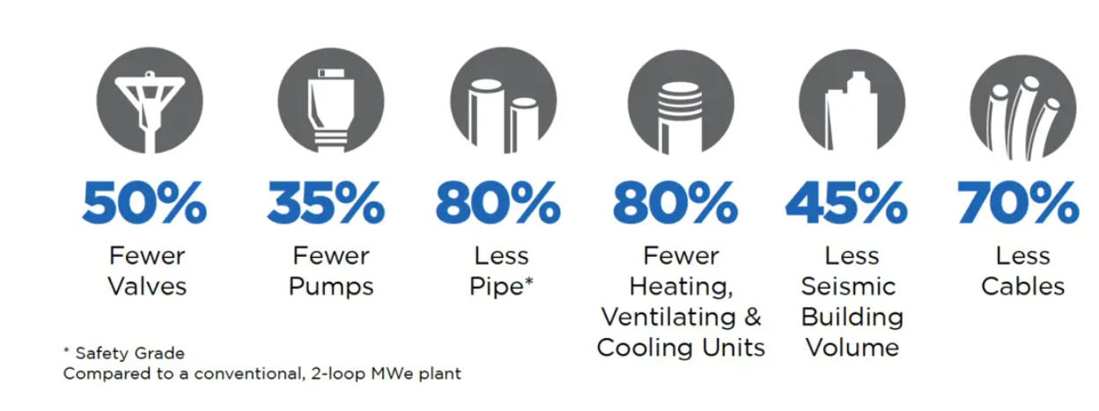
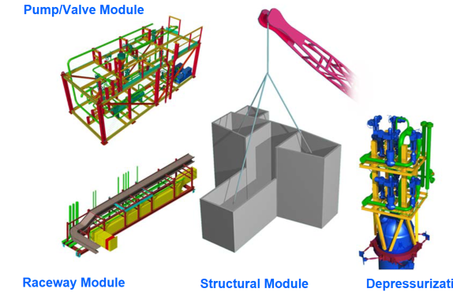
Advanced Large Light-Water Reactors
Westinghouse AP1000
Based on existing 4-loop technology
Advanced passive features
  Passive condensation and natural recirculation
Large modular assembly construction
Reduced concrete, steel, and equipment per MW
High reliability and capacity factor

Slide 25
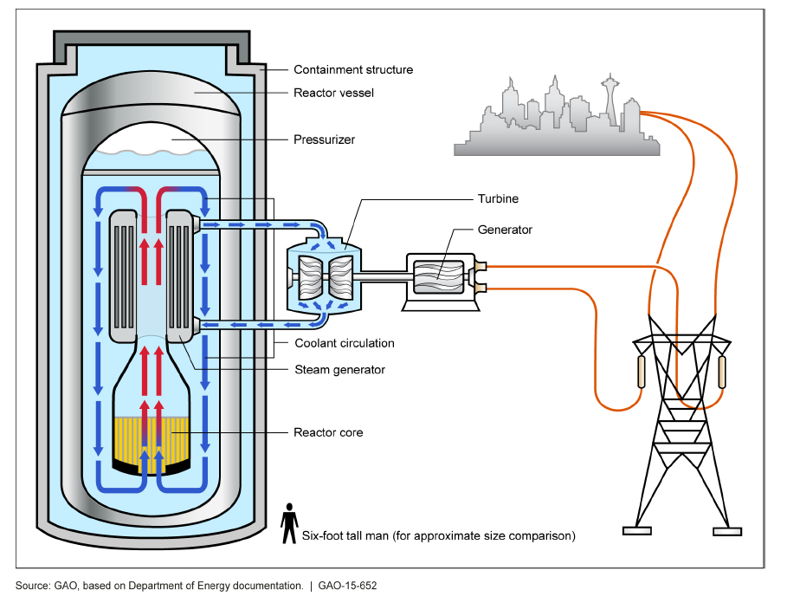
SMRs and Cost Advantage
Decrease construction time and cost using standard, factory-produced components.
Reduce the number of components and total materials using “integrated designs”
Modular construction on-site reduces the construction timeline.
Standardized designs may reduce the licensing timeline.

Slide 26
Nuclear Technologies,
Economic Opportunity
Employment (jobs)
Population | Plant Capacity by MWe
 | 100 | 300 | 500 | 700 | 900
< 20k | 121 | 207 | 313 | 443 | 573
20k – 40k | 139 | 253 | 387 | 547 | 707
40k – 90k | 144 | 266 | 408 | 576 | 744
90k – 200k | 150 | 283 | 436 | 616 | 795
> 200k | 178 | 352 | 548 | 773 | 998
Impacts result from activity at the power plant, the supply chain that supports it, and the community that surrounds it
Analysis compares the state of the world without the nuclear power plant to the state with it
Economic Activity ($million)
Population | Plant Capacity by MWe
 | 100 | 300 | 500 | 700 | 900
< 20k | 57.4 | 167.5 | 278.3 | 389.7 | 501.1
20k – 40k | 61.0 | 177.2 | 294.2 | 412.0 | 529.9
40k – 90k | 64.4 | 187.1 | 310.6 | 435.1 | 559.5
90k – 200k | 64.7 | 187.6 | 311.3 | 436.0 | 560.7
> 200k | 74.1 | 212.5 | 352.0 | 493.1 | 634.3
(Hansen 2024 here)

Slide 27
INL and Industry Are Investing to Build Capacity On Par with Demand.

Slide 28
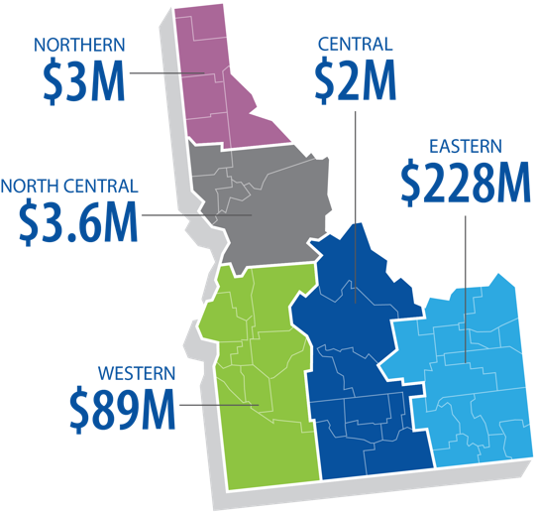





INL's FY24 economic impact on the State of Idaho was $4.29B, 13.8% increase from FY23
$4.29 Billion
total economic impact
For every ONE INL job, another TWO jobs are created in other industries.
More than 12,600 other Idaho jobs depend on INL operations
Idaho’s 5th largest public and private employer
$326M in subcontracts to Idahoan companies
($448M with small businesses)
Average Salary (all staff)
$125k
Acquisitions • Supplier diversity • Technology deployment
Notes:
23-50477-R1_Economic_Impact
FY22 numbers for comparison and % increase in FY23:
$3.38B impact- 11.5% increase
6th largest employer- Same
$243M in subcontracts- 19.3% increase
For every 1 INL job another 2.01 creates- 5.5% decrease (The decrease from 2.01 to 1.88 is a result of changes in the underlying data that feeds the model. That data includes industry spending patterns and household spending statistics that are updated each year by the Bureau of Economic Analysis and the Bureau of Labor Statistics. Based on that data those multipliers would decrease if businesses or households make more purchases outside of Idaho than they did last year.)
11,000 Idaho jobs- Same (Last year the exact number of additional jobs supported by INL was 10,985 and this year it was 11,137, it was a slight increase but rounding mutes things a little. Even though we spent more, the federal data is suggesting that less of that money and those jobs are staying in Idaho.)
$108,142 average- 10.5% increase (inflation fell to 3% in November 2023 compared to around 8% in 2022)
Average salary calculated using payrolll less employee income tax over total employment as it was the most consistent with the previous report. Total labor income over employment can get that number up closer to $150,000.
All staff - $119.4k
Exempt only (less SLT, Seconded, Emeritus) - $138.7k
Non-exempt and Union (less Interns) - $84.6k
All staff (less SLT, Interns, seconded, emeritus) - $120.0k
Top 10 public/private employers in Idaho as of 2021 (no 2022 update yet): https://lmi.idaho.gov/data-tools/business-listings/
St. Luke’s Health System
Wal-Mart
Micron
St. Alphonsus Health System
Albertsons
Battelle Energy Alliance
J.R. Simplot Company*
Fred Meyer Stores
* The businesses in the 7th and 8th positions did not give permission for their names to be included

Slide 29

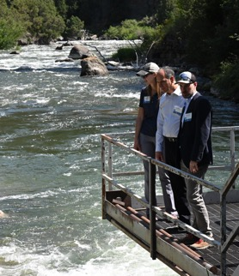
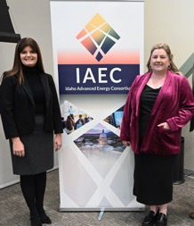
Advancing opportunities and the economy in our communities and broader region
Active Laboratory Directed Research and Development projects with regional universities
27
16
Regional universities and colleges partnering with INL
Idaho students engaged through INL’s K-12 STEM initiatives
Interns hosted at INL from regional states
25
275
THOUSAND
$392M
Value of subcontracts from regional states
Tech Hub collaborators from industry, universities, and tribal nations
Industry leaders attending supplier engagement workshops
45⁺
500
$3.77B
FY23 economic impact in Idaho
ALASKA • IDAHO • MONTANA • NEVADA • UTAH • WYOMING

Slide 30
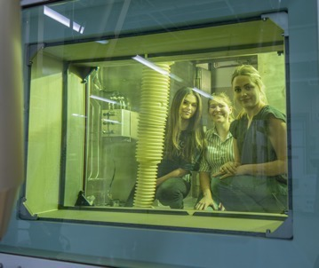
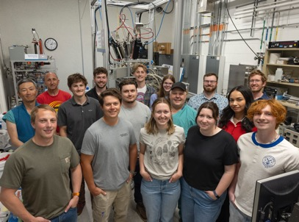


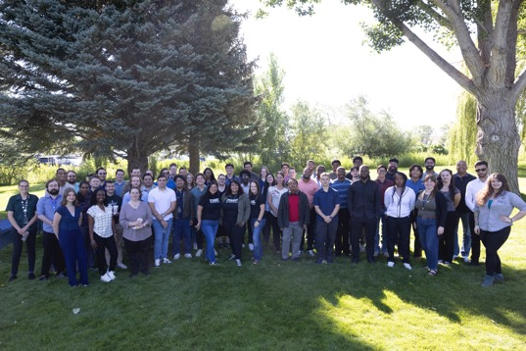
Building our talent pipeline: interns
555
Interns
41%
(Idaho, Montana, Wyoming, Utah, Nevada, Oregon, Washington)
Regional
58%
1%
Other States
International
TOP
FIVE
Nuclear engineering; Mechanical engineering; Computer science; Electrical engineering; Chemical engineering
Majors
143
Colleges
& Universities

Slide 31
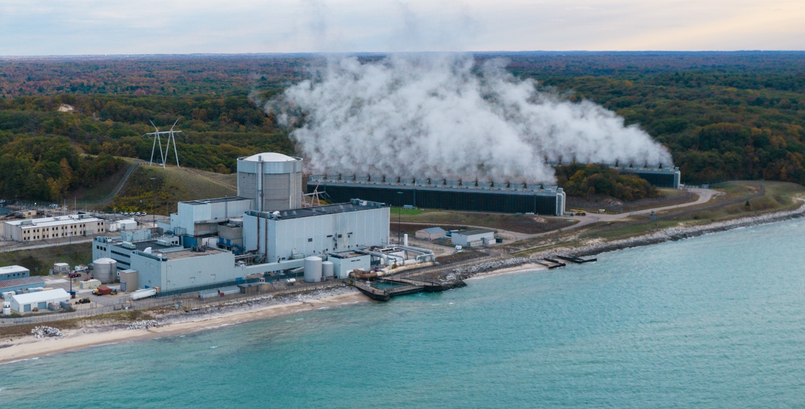
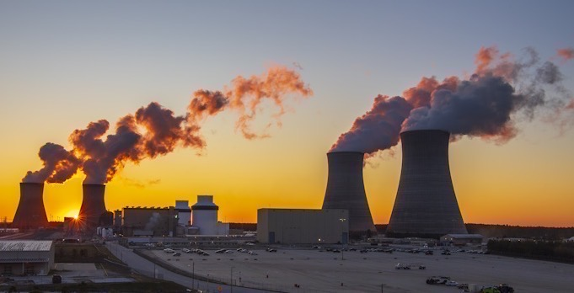
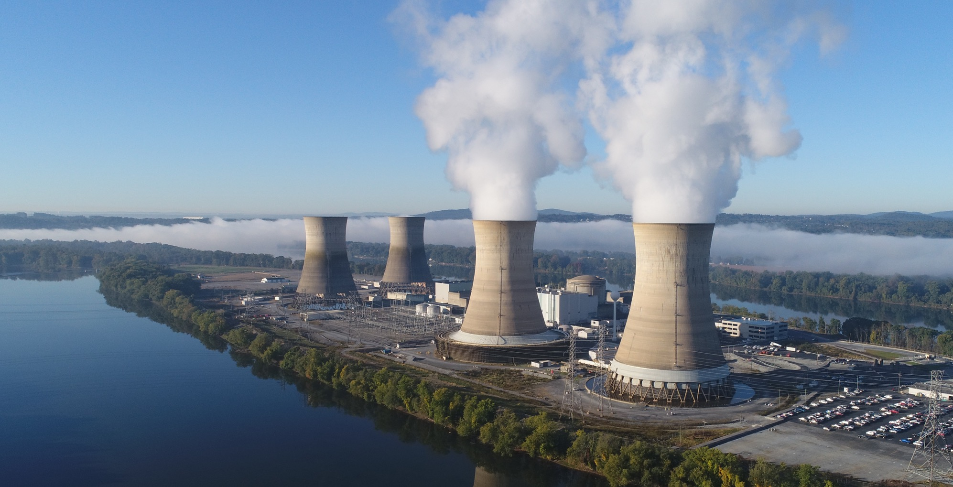

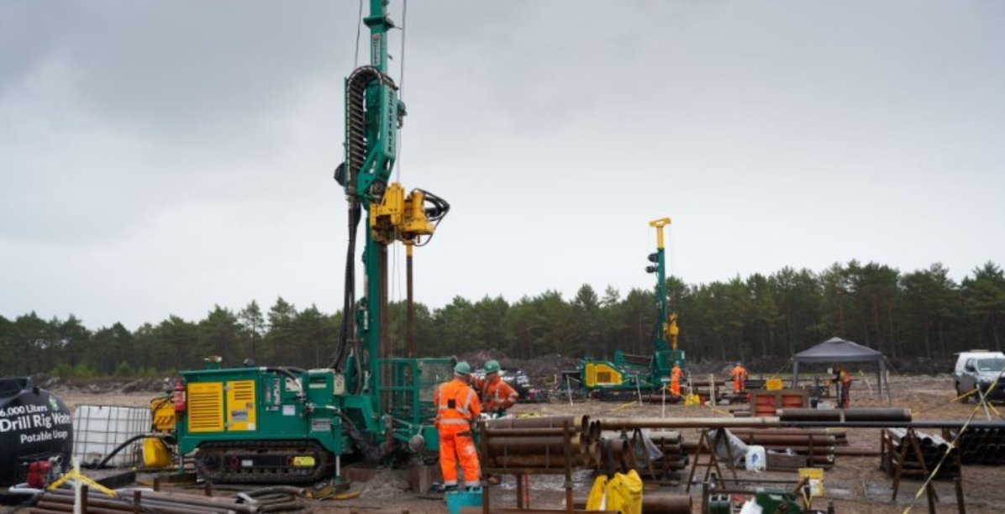
Deals, Partnerships and
Industry Action
Palisades Restart: Advanced by $1.5B from the DOE Loan Program Office
Vogtle Units 3 & 4 are Producing Clean, Reliable, Economic Power
Microsoft: Power Purchase Agreement enables the Launch of Crane Clean Energy Center
Oracle Plans to Use 3 SMRs to Power a Gigawatt-Scale Data Center
Partnership between Google and Kairos Will Enable up to 500 MW of SMRs
X-Energy Secures $500M in Financing from Amazon Climate Pledge Fund and Other Key Investors
Poland Announces $16B Investment it its First Nuclear Plant

Slide 32














14 Major
Global Banks and Financial Institutions
Pledge Support
for Nuclear
Power
Notes:
https://world-nuclear.org/news-and-media/press-statements/14-major-global-banks-and-financial-institutions-express-support-to-triple-nuclear-energy-by-2050-23-september-2024

Slide 33
Conclusion
Exceptional circumstances can accelerate
the gradual process of energy transition.
~Vaclav Smil
The market is a voting machine in the short run,
but a weighing machine in the long run.
~Benjamin Grahm
The best way to predict the future is to create it.
~Peter Drucker
Notes:
This insight, often discussed by Buffett to describe market volatility versus fundamental value, highlights that while stocks are driven by popularity and emotion in the short term, they ultimately reflect their intrinsic business value over time.

Slide 34
Contact Information
Jason K Hansen, PhD
Distinguished Research Economist
Idaho National Laboratory
Jason.Hansen@inl.gov

