Slide 1

Idaho
Economic
Outlook
Karl R. Geisler, PhD
Professor of Economics & Chair | Dept. of Econ. & Finance
Director | Center for Economic Research & Quantitative Analysis
College of Business | Idaho State University

Slide 2

Acknowledgements
Steven Peterson, MS. Associate Clinical Professor, College of Business and Economics. University of Idaho (stevenp@uidaho.edu)
Kyle Brookman, MS. Lecturer, Department of Economics College of Business and Economics. Boise State University (kylebrookman@boisestate.edu)

Slide 3
Idaho Ranking:
Gross State Product Growth
Statewide Economy
Q.Year | GSP Growth | Rank
Q1.2024 | 2.2% | 13
Q2.2024 | 9% | 2
Q3.2024 | 5.7% | 1
Q4.2024 | 3.2% | 7
Q1.2025 | -3.7% | 44
Q2.2025 | 3.2% | 32
Source: U.S. Bureau of Economic Analysis

Slide 4
Diverse Economic Base
Statewide Economy
Source: U.S. Bureau of Economic Analysis

Slide 5
Statewide Economy
Contributions to GSP | % in 2024
Finance, insurance, real estate, rental, and leasing | 19.506%
Professional and business services | 12.993%
Educational services, health care, and social assistance | 10.227%
Manufacturing | 8.933%
Retail trade | 8.270%
State and Local (Government) | 7.976%
Wholesale trade | 6.074%
Construction | 5.684%
Agriculture, forestry, fishing and hunting | 3.921%
Arts, entertainment, recreation, accommodation, and food services | 3.822%
Information | 3.405%
Transportation and warehousing | 2.790%
Other services (except government and government enterprises) | 1.697%
Utilities | 1.404%
Federal civilian (Government) | 2.209%
Mining, quarrying, and oil and gas extraction | 1.072%
Military (Government) | 0.636%
Source: U.S. Bureau of Economic Analysis

Slide 6
Statewide Economy
Employee Compensation by Industry (in thousands) | 2024
Health care & social assistance | $8,556,831
State & local (Government | $8,212,797
Manufacturing | $7,304,729
Professional, scientific, & technical services | $5,840,852
Construction | $5,460,241
Retail trade | $4,919,906
Wholesale trade | $3,729,084
Finance & insurance | $3,369,636
Administrative & support & waste management & remediation services | $3,142,346
Accommodation & food services | $2,503,347
Transportation & warehousing | $2,169,842
Employee Compensation by Industry (in thousands) | 2024
Federal civilian (Government) | $1,939,281
Other services (except gov’t) | $1,734,579
Management of companies & enterprises | $1,438,771
Farm compensation | $1,252,871
Educational services | $887,865
Real estate & rental & leasing | $734,451
Military (Government) | $671,761
Arts, entertainment, & recreation | $627,468
Forestry, fishing, & related activities | $542,536
Utilities | $412,365
Mining/quarrying/oil & gas extract. | (D)
Information | (D)
Source: U.S. Bureau of Economic Analysis

Slide 7
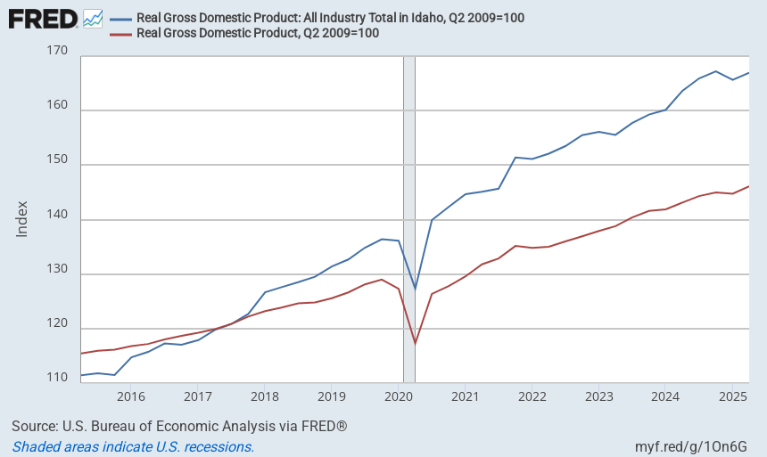
Idaho Compared to the Nation
Statewide Economy

Slide 8
2024 Personal Income for the US and ID
Personal Income
Region | Growth Rate | Rank | Per Capita Personal Income | Rank
Idaho | 5.27% | 8th | $ 62,323 | 43rd
U.S. | 4.57% | - | $ 73,204 | -
Source: US Bureau of Economic Analysis/ Rankings include the District of Columbia

Slide 9
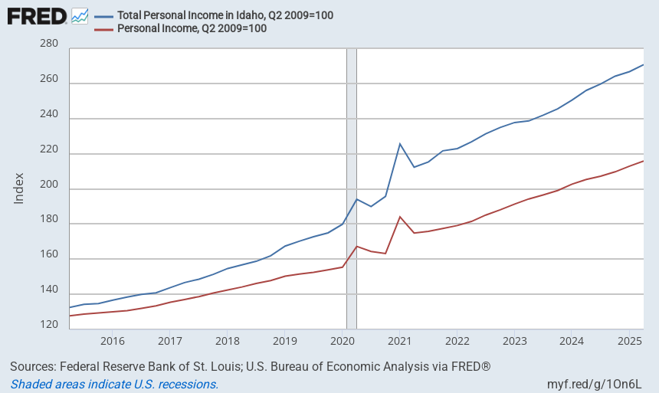
Total Personal Income:
Statewide Economy

Slide 10
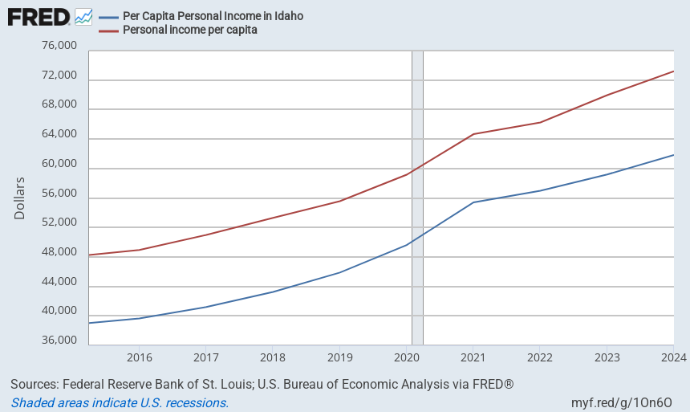
Per Capita Income (in Dollars)
Statewide Economy

Slide 11
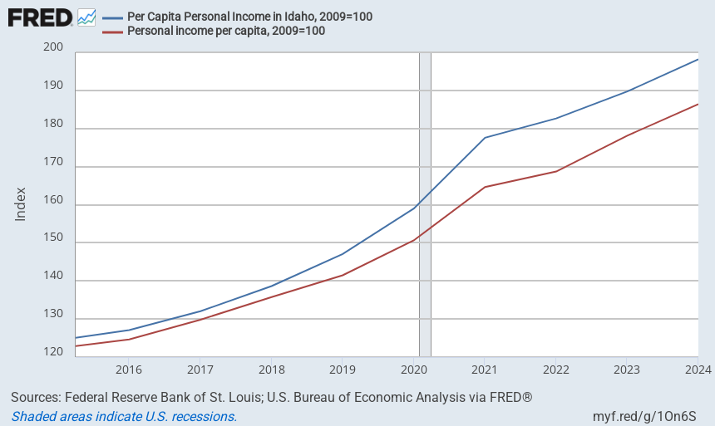
Per Capita Personal Income (Indexed)
Statewide Economy

Slide 12
FY 2024 Forecast
Personal Income
Fiscal Year | Forecasted PI (Millions) | Forecasted Growth Rate | Actual PI (Millions) | Actual Growth Rate | Missed by
2024 | $ 119,605.01 | 5.397% | $120,032.6 | 5.77% | 0.17% (low)
2025 | $ 126,330.91 | 5.623% | $ 128,481.1 | 7.04% | 1.70% (low)
2026 | $ 133,188.41 | 5.428% | - | -
FY 2025 Forecast
Fiscal Year | Forecasted PI (Millions) | Forecasted Growth Rate | Actual PI (Millions) | Actual Growth Rate | Missed by
2025 | $127,143.01 | 5.92% | $ 128,481.1 | 7.04% | 1.05% (low)
2026 | $135,343.47 | 6.45% | - | -
2027 | $144,624.77 | 6.86% | - | -

Slide 13
Idaho Personal Income Forecast
Personal Income
Fiscal Year | PI (Millions) | Growth Rate
2017 | $ 69,157.45 | 5.00%
2018 | $ 74,011.35 | 7.02%
2019 | $ 79,685.28 | 7.69%
2020 | $ 87,507.60 | 9.47%
2021 | $ 98,329.38 | 13.98%
2022 | $ 105,069.88 | 7.62%
2023 | $ 113,480.68 | 6.67%
2024 | $ 120,032.63 | 5.77%
2025 | $ 128,481.10 | 7.04%
2026 | $ 134,784.19 | 4.91%
2027 | $ 142,377.71 | 5.63%
2028 | $ 149,789.44 | 5.21%
Forecast Average Growth: 5.25%

Slide 14
Idaho Tax Revenue Forecast
State Tax Revenue
($ MILLION) | ACTUAL | Projected | FORECAST
SOURCE | FY 2025 | FY 2026 | FY 2027 | FY 2028
INDIVIDUAL INCOME TAX | $2,418.85 | $2,701.13 | $2,793.78 | $2,938.22
% CHANGE | 8.53% | 11.67% | 3.43% | 5.17%
CORPORATE INCOME TAX | $890.61 | $614.97 | $655.18 | $683.95
% CHANGE | 2.67% | -30.95% | 6.54% | 4.39%
SALES TAX | $2,079.40 | $2,017.23 | $2,100.34 | $2,218.79
% CHANGE | 14.01% | -2.99% | 4.12% | 5.64%
PRODUCT TAXES | $66.70 | $64.66 | $66.52 | $69.18
% CHANGE | -8.73% | -4.10% | 4.00% | 4.00%
MISC. REVENUE | $421.40 | $353.60 | $367.74 | $382.45
% CHANGE | 8.57% | -16.09% | 4.00% | 4.00%
TOTAL GENERAL FUND | $5,876.96 | $5,750.88 | $5,983.56 | $6,292.59
% CHANGE | 9.21% | -2.15% | 4.05% | 5.16%

Slide 15
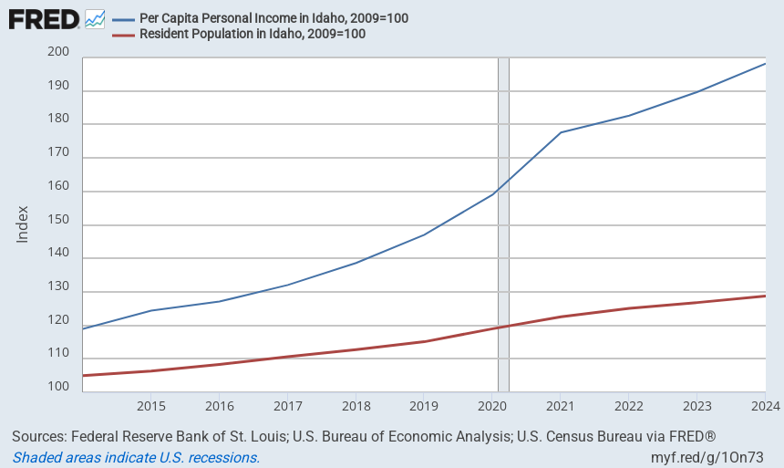
Per Capita Personal Income vs Population Growth (Indexed)

Slide 16
Strong Population & Employment Growth
Population
Population Growth 2020-2024
Population Growth
July 2023 – July 2024
Employment Growth
Nov. 2024 - Nov.2025
Rank | State | %
1 | .Idaho | 8.8%
2 | .Florida | 8.5%
3 | .Texas | 7.3%
4 | .Utah | 7.1%
5 | .South Carolina | 7.0%
6 | .Delaware | 6.3%
7 | .Arizona | 5.9%
8 | .North Carolina | 5.8%
9 | .Nevada | 5.2%
10 | .Montana | 4.9%
Rank | State | %
1 | .District of Columbia | 2.2%
2 | .Florida | 2.0%
3 | .Texas | 1.8%
4 | .Utah | 1.8%
5 | .South Carolina | 1.7%
6 | .Nevada | 1.7%
7 | .Idaho | 1.5%
8 | .North Carolina | 1.5%
9 | .Delaware | 1.5%
10 | .Arizona | 1.5%
Rank | State | %
1 | Missouri | 2.0%
2 | South Carolina | 2.0%
3 | North Carolina | 1.7%
4 | Hawaii | 1.6%
5 | Pennsylvania | 1.6%
6 | Arkansas | 1.3%
7 | Idaho | 1.3%
8 | Minnesota | 1.3%
9 | New Mexico | 1.3%
10 | Utah | 1.1%
Source: Census
Source: Census
Source: Bureau of Labor Statistics

Slide 17
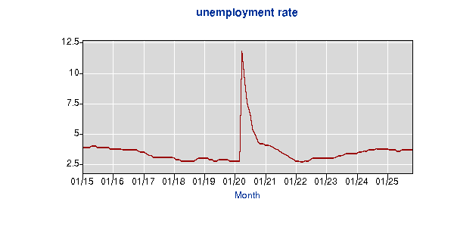
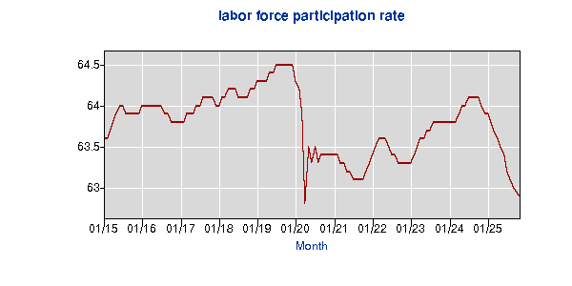
Idaho Nov. 2025 Data
Unemployment Rate: 3.7%
Labor Force Participation Rate: 62.9%
.
Employment
Source: Bureau of Labor Statistics Local Area Unemployment Statistics
Notes:
21st lowest rate (tied with Arkansas, Colorado, Iowa, Mississippi, Oklahoma, & Wisconsin)

Slide 18
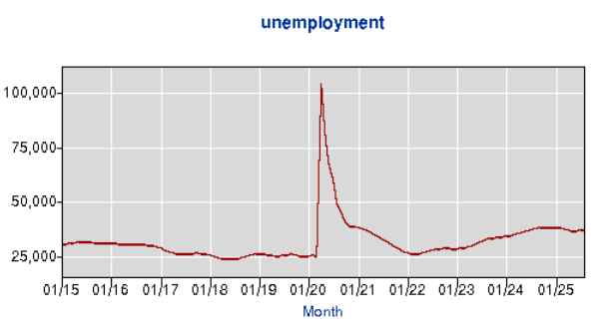
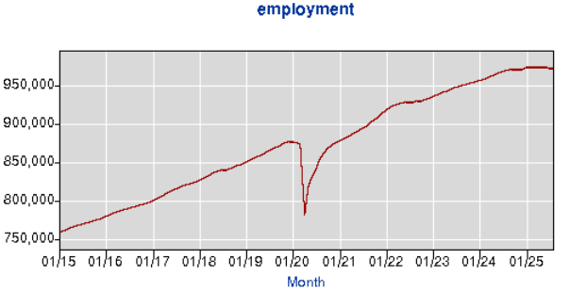
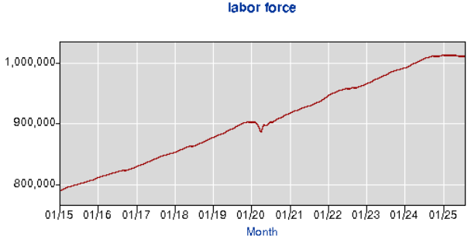
Idaho Employment Levels
Employment
Graphs from BLS.gov

Slide 19
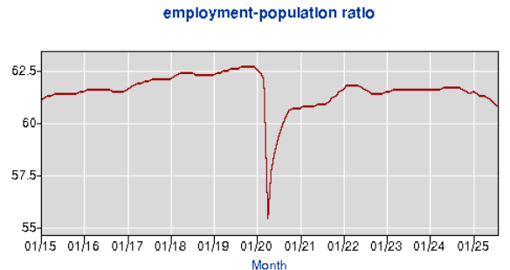
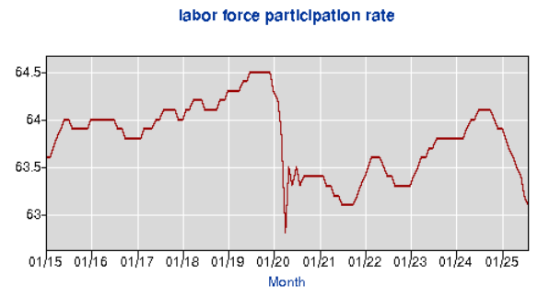
Changes to Labor Force Composition?
Employment
Graphs from BLS.gov

Slide 20
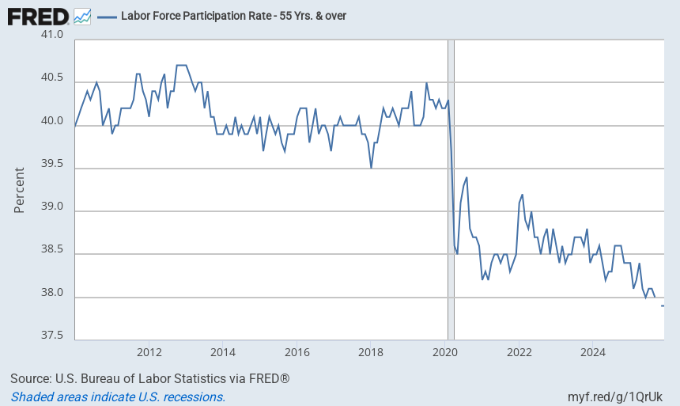
Employment

Slide 21
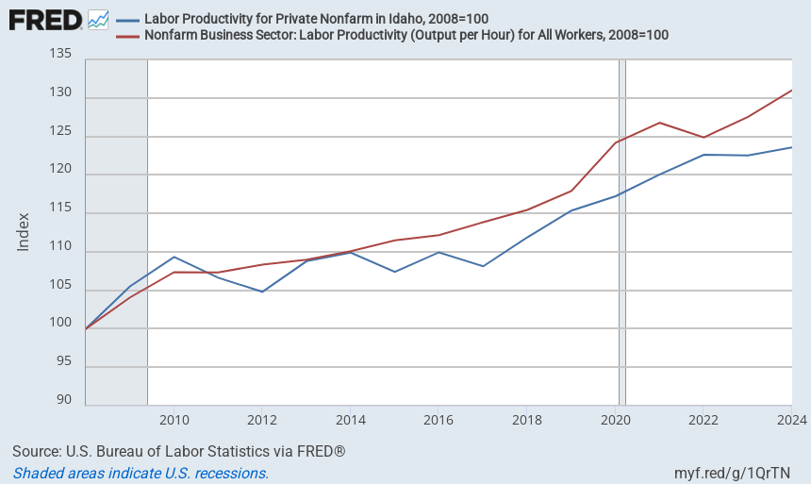
Productivity
Employment

Slide 22
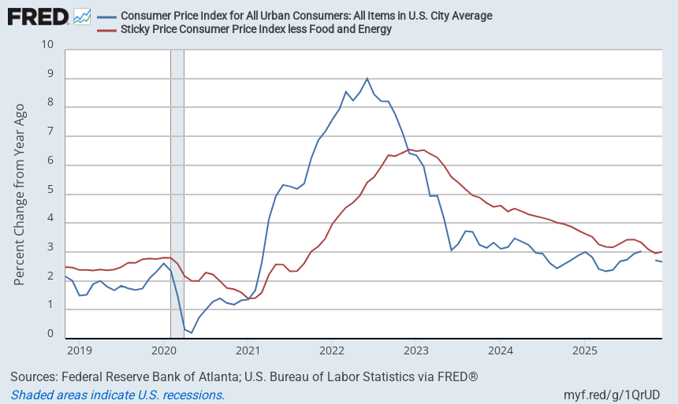
Inflation Moderation
Inflation

Slide 23
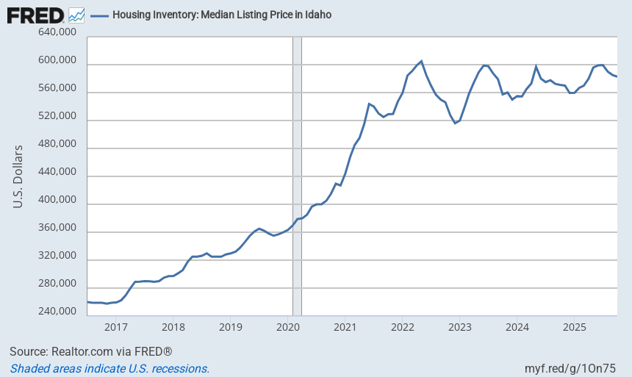
Idaho Median House Price
Inflation

Slide 24
Unanswered Questions
Idaho Labor Force Growth?
  State Employment & Unemployment levels steady
  Plateau of Labor Force → declining Labor Force Participation Rate?
Inflation down/steady/back up?
  Continued Fed Target Rate Decreases?
Debt
  Private Non-Bank Credit between $1.3 & $2.1 Trillion
  US National Debt: $38 Trillion (≈120% of GDP)
  US Credit Card Debt: $1.23 Trillion (5.75% higher than a year ago)
    Delinquency Rate ≈ 3% since Q4 2024, last above 3% in Q1 2012

Slide 25
Idaho’s Economic Outlook
Tailwinds
Headwinds
Crosswinds
Diverse State Economy
Growing Incomes & GSP
Labor Productivity
Slowing Pop. Growth
Inflation
Slowing National Growth
Low Consumer Sentiment

Slide 26
Questions?

Slide 27
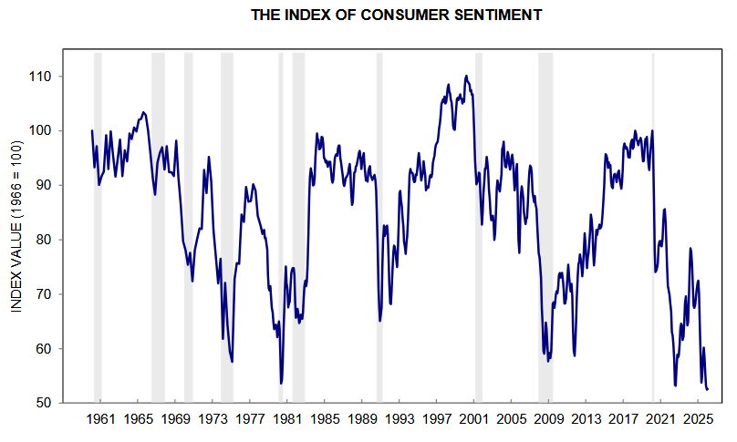
Source: University of Michigan Surveys of Consumers

