Slide 1
Comparative Analysis of Labor and Education Trends in Idaho and Future Career Forecasts
Patrick Pinheiro
VP of Risk Management
Idaho Central Credit Union
Notes:
AI-generated content may be incorrect. --- This presentation provides a comprehensive overview of labor and education trends in Idaho and the United States over the last decade. We will also delve into recession-proof professions and forecasted top careers and skills for the next 20 years.

Slide 2
Disclaimer: The views expressed in this presentation are my own and do not necessarily reflect the views of my employer or its management.
Any opinions, analyses, or conclusions are solely those of the author and do not represent the official position of ICCU.

Slide 3
BIO
Professional:
VP of Risk Management, ICCU
Internal Consultant, Federal Reserve Bank of Chicago
Corporate Auditor, Zions Bancorporation
ERS Consultant, Deloitte & Touche
Academic:
MBA - Northwestern University – Kellogg school of Management
BS Finance – Brigham Young University – Marriott School of Business
BA in Economics – Brigham Young University
Hobbies:
AI/ML (Options Trading and Alternative Finance Pricing Bots)
Markets and Leadership Podcasts
MMA
Soccer
Patrick Pinheiro, VP of Risk Management

Slide 4
Agenda Items
Labor Trends in Idaho
Education Trends in Idaho
Business Cycles: Professions that are Cyclical and Anti-Cyclical
Forecasted Top 5 Careers/Skills for the Next 20 Years
Education Investment Considerations
Notes:
We will start by comparing labor trends in Idaho and the USA, examining employment rates, job growth, and industry-specific trends. Then, we will analyze education trends in Idaho and the USA, including graduation rates, academic performance, and investment in education infrastructure. Next, we will explore the impact of budget cuts on Idaho's public education quality. We will then focus on recession-proof professions, identifying the top 10 professions that have remained stable during economic downturns. Finally, we will discuss forecasted top careers and skills for the next 20 years, including emerging technology roles, sustainability and green jobs, and healthcare and biotechnology advances.

Slide 5
Labor Trends in Idaho
Notes:
Idaho and the USA have experienced different labor trends over the last decade. Idaho's employment rate has been consistently higher than the national average, while the USA has experienced higher job growth rates. We will also examine industry-specific trends and the impact of economic policies on both Idaho and the USA.

Slide 6
Employment Rates and Job Growth
Employment Rate
Idaho's employment rate has been consistently higher than the national average. Currently, the state has an unemployment rate of 3.8% compared to the national rate of 4.4%.
Job Growth
The USA has experienced higher job growth rates than Idaho, with an average of 1.1% compared to Idaho's average of 0.9%.
Does this data tell the whole story?
Notes:
Idaho's employment rate has been consistently higher than the national average, with a current rate of 3.8% compared to the national rate of 4.4%. However, the USA has experienced higher job growth rates, with an average of 1.1% compared to Idaho's average of 0.9%.

Slide 7
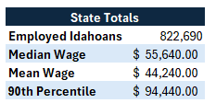
Idahoans’ top 15 professions by volume
Idaho Dept of Labor - May 2023
Notes:
Idaho has seen job growth in construction, healthcare, and professional services, while the USA has seen job growth in healthcare, professional services, and leisure and hospitality. However, Idaho has lost jobs in manufacturing, while the USA has gained jobs in this sector.

Slide 8
US Pro-cyclical Jobs
Bureau of Labor Statistics and National Bureau of Economic Research

Slide 9
Education Trends in Idaho
Notes:
Education is a key driver of economic growth and development. We will compare education trends in Idaho and the USA, including graduation rates, academic performance, and investment in education infrastructure.

Slide 10
Graduation Rates and Academic Performance
High School Graduation Rates
Idaho's high school graduation rate has been consistently lower than the national average, with a current rate of 80% compared to the national rate of 85%. This is an area of concern that needs to be addressed to improve the state's overall academic performance.
Fourth-Grade Reading Scores
Idaho's fourth-grade reading scores have improved in recent years and are now on par with the national average. This is a positive development that shows Idaho is making progress in improving its academic performance.
Notes:
Idaho's high school graduation rate has been consistently lower than the national average, with a current rate of 80% compared to the national rate of 85%. However, Idaho's fourth-grade reading scores have improved in recent years and are now on par with the national average.

Slide 11
Idaho state board of education – Postsecondary Education
I couldn’t find the number of students NOT seeking remediation, that took English or Math!

Slide 12
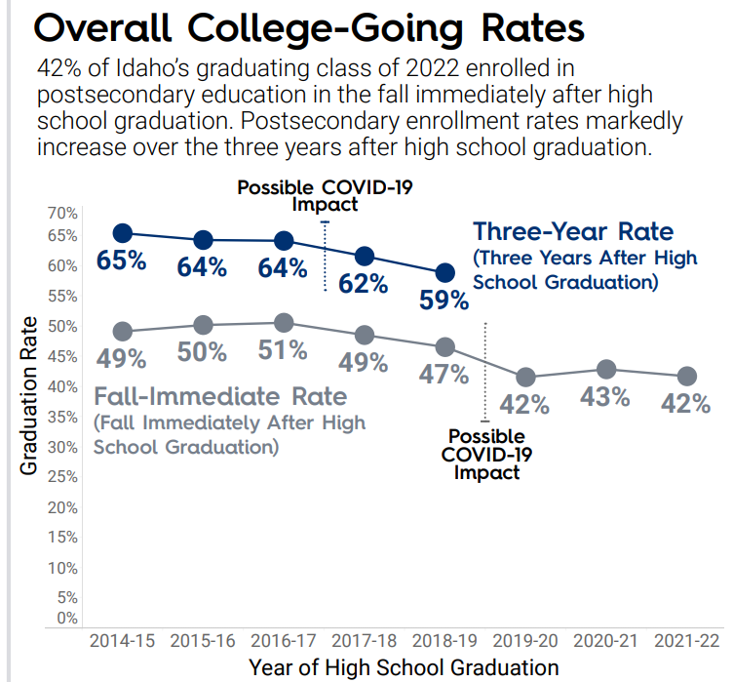
Overall College-Going Rates
42% of Idaho’s graduating class of 2022 enrolled in postsecondary education in the fall immediately after high school graduation.
Postsecondary enrollment rates markedly increase over the three years after high school graduation.

Slide 13
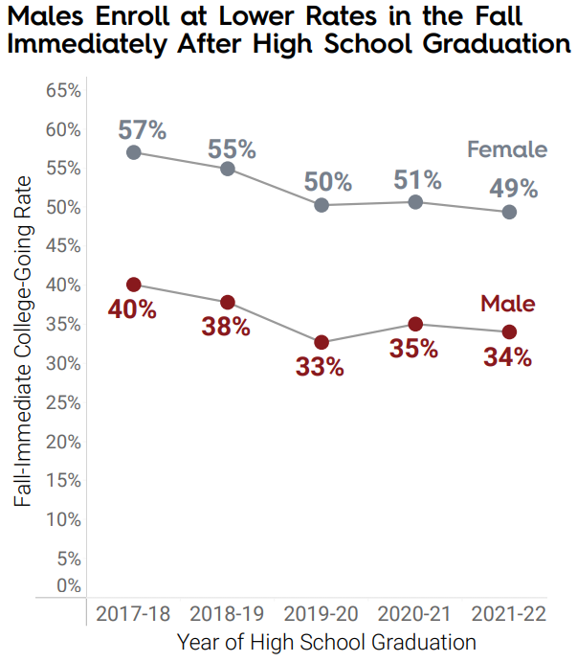
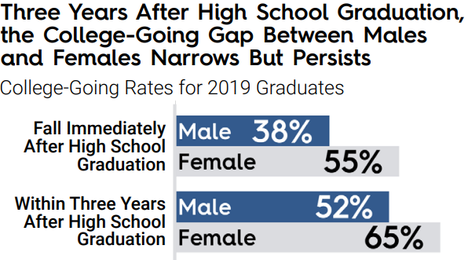
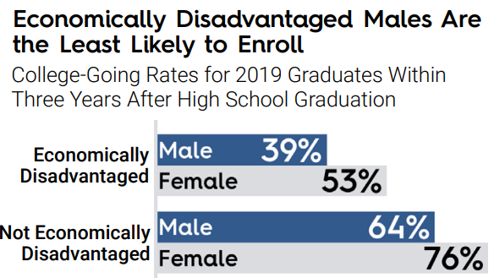
Gender and College-Going Rates

Slide 14
Idaho’s investment in Education
Notes:
Budget cuts have affected public education quality in Idaho. We will examine the historical budget allocations for education in Idaho, the effects of budget cuts on public education quality, and community and stakeholder responses to these cuts.

Slide 15
Investment in Education Infrastructure
Investment in Education Infrastructure
Investment in education infrastructure has a significant impact on the quality of education. Adequate funding for school buildings, technology and other necessary resources can ensure a high-quality learning environment for students.
Investment levels of Idaho and the USA
Investment levels in education infrastructure vary significantly across the United States. Idaho, for instance, has lower levels of investment compared to other states. This investment impacts the quality of education students receive.
Impact of Investment on Student Outcomes
Investment in education infrastructure has a direct impact on student outcomes, including academic achievement, graduation rates, and future success. Adequate investment in education infrastructure can ensure a brighter future for students.
Notes:
Investment in education infrastructure, such as school buildings and technology, is crucial for providing high-quality education. We will explore the investment levels of Idaho and the USA and the impact of this investment on student outcomes.

Slide 16
Per-Pupil Spending by State (2023) with Budget and GDP Percentages
Idaho's Education Funding Trends:
Fiscal Year 2018: Idaho's per-pupil spending decreased by 11% from 2008 to 2016, with only seven states experiencing a steeper decrease. Idaho Education News
Fiscal Year 2020: The state allocated $2.14 billion in total school funding, including dedicated and federal funds, marking a $99.4 million (4.9%) increase over the previous year. The Lewiston Tribune
Fiscal Year 2024: Idaho enacted a budget reporting $5.1 billion in general fund spending, a 12% increase over the previously enacted budget. Urban Institute

Slide 17
Potential improvements – Impact on GDP, Tax Revenue, and education
Notes:
During times of economic downturn, certain professions have remained stable and even experienced growth. We will identify the top 10 recession-proof professions over the last 15 years and explore the reasons for their stability.

Slide 18
Factors to consider (2024 Data)
State | GDP (in billions) | Rank | Median Income | State Budget (in billions) | State Tax Revenue (in billions) | % College Graduates | % College Graduates in STEM
California | $4,080.18 | 1 | $123,988 | $310.8 | $220.59 | 38% | 10%
Texas | $2,694.52 | 2 | $86,987 | $250.3 | $86.77 | 32% | 8%
New York | $2,284.36 | 3 | $91,366 | $220.1 | $125.18 | 41% | 9%
Florida | $1,695.27 | 4 | $73,784 | $150.2 | $62.98 | 30% | 7%
Illinois | $1,132.14 | 5 | $82,553 | $140.5 | $62.98 | 38% | 8%
Idaho | $80.91 | 41 | $66,474 | $5.5 | $5.8 | 28% | 6%

Slide 19
the top three industries in Population participation in the top 5 GDP states
State | Industry 1 | Median Income 1 | Industry 2 | Median Income 2 | Industry 3 | Median Income 3
California | Technology | $120,000 | Healthcare | $95,000 | Finance | $110,000
Texas | Energy | $100,000 | Technology | $105,000 | Healthcare | $90,000
New York | Finance | $130,000 | Healthcare | $100,000 | Technology | $115,000
Florida | Tourism | $60,000 | Healthcare | $85,000 | Retail | $50,000
Illinois | Manufacturing | $80,000 | Healthcare | $90,000 | Finance | $105,000
Idaho | Agriculture | $55,000 | Manufacturing | $70,000 | Technology | $85,000

Slide 20
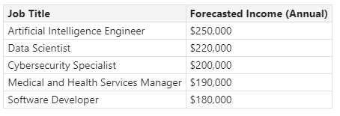
top 5 earning jobs projected for the next 20 years

Slide 21
McKinsey's Top 5 Skills for the Future
Critical thinking and problem-solving are essential for complex decision-making.
Emotional intelligence helps in understanding and managing interpersonal relationships.
Creativity facilitates innovation and adaptability in a changing environment.
Digital literacy is crucial for navigating technology and data analysis.
Collaboration skills are vital for teamwork in diverse environments.
Notes:
McKinsey emphasizes the importance of skills that will shape the future workforce. Critical thinking and problem solving allow individuals to tackle complex challenges effectively. Emotional intelligence fosters better interactions, while creativity drives innovation. Digital literacy is essential in today's tech-driven world. Finally, collaboration skills are crucial for working in diverse teams, ensuring effective communication and teamwork.

Slide 22
Chinese education – 4x STEM Graduates as the US

Slide 23
Other Considerations that could have been included in this presentation
Perhaps it would be interesting to obtain data on the number of businesses that are Passthroughs for tax purposes such as S-Corp or Sole Proprietorship
Another interesting data we could have looked at would be number of SBA Loans vs SBA Loans that are delinquent or in default
Tax revenue generated by small businesses
Small businesses contribution to the State’s GDP

Slide 24
Brainstorming: What are some thoughts on solutions, or challenges that came to mind during this presentation? I will start with a few thoughts…

Slide 25
Challenges
Potential Solutions
Increasing Taxes on People will squeeze their already comparatively low, household disposable income.
Lack of student confidence to attend College and/or household income demanding a “quicker but lower payout.”
Lack of infrastructure to attract remote workers to move to the State (i.e., perception of quality of local education K-12, local businesses of national brands, etc)
Tax incentives to bring businesses to different counties in the state.
Incentivize stronger STEM programs, by attracting high caliber educators from K-12, could enhance confidence in enrolling in higher education.
Leverage remote-work to attract higher income earners to move to the state

