Slide 1
Idaho Labor Market Outlook
Dr. Iris Buder
Associate Professor of Economics
Department of Economics & Finance
College of Business

Slide 2
Labor Force Participation
Idaho
USA
Source: Federal Reserve Bank of St. Louis (FRED), 2024

Slide 3
Unemployment Rate
USA
Idaho
Source: Federal Reserve Bank of St. Louis (FRED), 2024

Slide 4
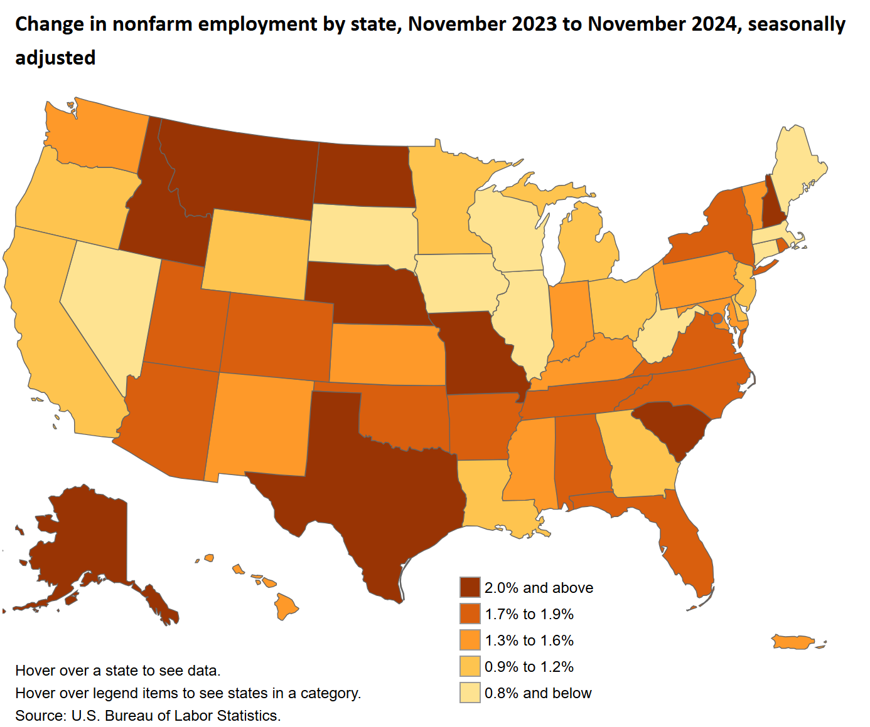
US: +1.4%
Idaho: 3.1%
Alaska: 2.8%
Missouri: 2.7%
S. Carolina: 2.6%
Montana: 2.4%

Slide 5
Key Employment % Changes: 2023-2024
Education & Health Services: 7.5%
Manufacturing: 7.5%
Construction: 5.2%
Mining & Logging: -6.8%
Information: -6.4%
Leisure & Hospitality: -2.8%
Source: Bureau of Labor Statistics (https://www.bls.gov/eag/eag.id.htm), 2024

Slide 6
Number of unemployed persons per job opening, seasonally adjusted
Source: Bureau of Labor Statistics, 2024

Slide 7
Challenges
Tight labor market
Demographic changes
Turnover rate
Population Growth and Migration
Supply or cost of workers

Slide 8
Occupation Projections: 2022 – 2032
Total Growth:
14.3%
Construction & Extraction Occupations: 27.4%
Healthcare Support Occupations: 19.1%
Healthcare Practitioners & Technical Occupations: 18.6%
Personal Care & Service Occupations: 18.5%
Farming, Fishing, & Forestry Occupations: 16.6%
Architecture & Engineering Occupations: 16.3%
Source: Long Term Occupational Projections, Idaho Department of Labor (2024)

Slide 9
STEM Employment Projections: 2022 – 2032
Total STEM Employment: 23.5%
Health Occupations: 25.1%
Life and Physical Science, Engineering, Mathematics, and Information Technology Occupations: 17.3%
Architecture Occupations: 13.3%
Social Science Occupations: 12%
Source: Long Term Occupational Projections, Idaho Department of Labor (2024)

Slide 10
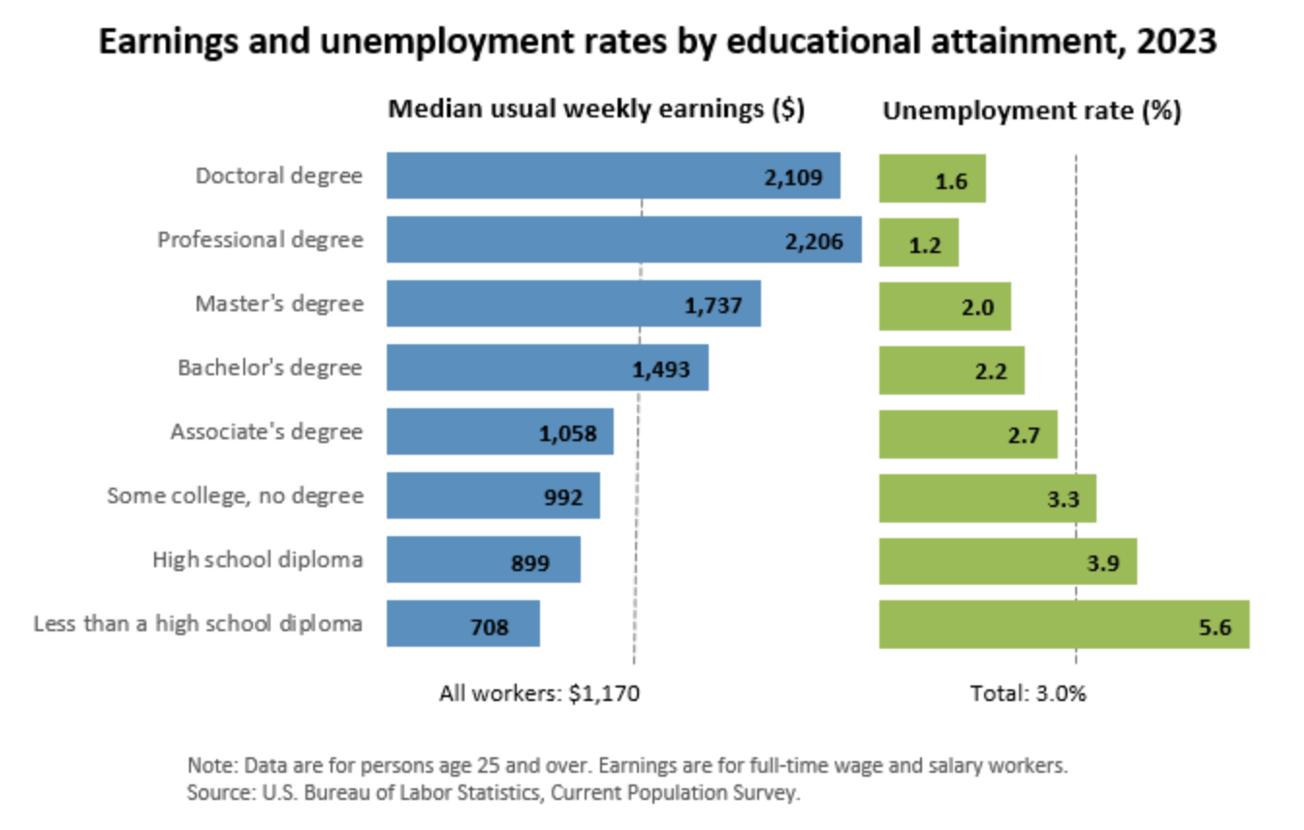
Education & Labor

