Slide 1
2025 Idaho Economic Outlook Symposium
Real Estate Outlook
Fred Parrish, MBA
Notes:
Introduce myself first
Real Estate Background
Teaching

Slide 2
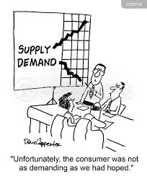
Introduction– Key Concepts
All real estate is local
It all comes down to Supply and Demand
Notes:
These two things are so critical… and yet so often misunderstood

Slide 3
The Big Reveal
Surprise!
Notes:
I can’t tell you what is going to happen with the real estate market
I can talk to you about some things to look for and think about

Slide 4
It’s All Local… but not just that
Hyperlocal factors (Neighborhood, etc.)
Property Types
Residential
Single family houses, condominiums, cooperative apartments
Income Producing
Multifamily
Commercial
Office
Retail
Hotel/motel
Industrial/warehouse
Recreational
Institutional (special purpose)
Layers within property types
Notes:
One of the reasons I can’t tell you the outlook for the Real Estate Market is because… I don’t know what that means
How is the real estate market? It’s fantastic (Jim Johnston)
The truth is… it depends
I am going to talk mostly about single family housing… because that is what most people are interested in and that is where most of the data are gathered

Slide 5
Demand Side Factors
Population Growth
2025 Projected Population Growth– 2.5%
Growth by County, 2020-2023
Bannock– 4%
Bingham– 5%
Bonneville– 6%
Source: Legislative Services Office, Economic Outlook and Revenue Assessment Committee 2025

Slide 6
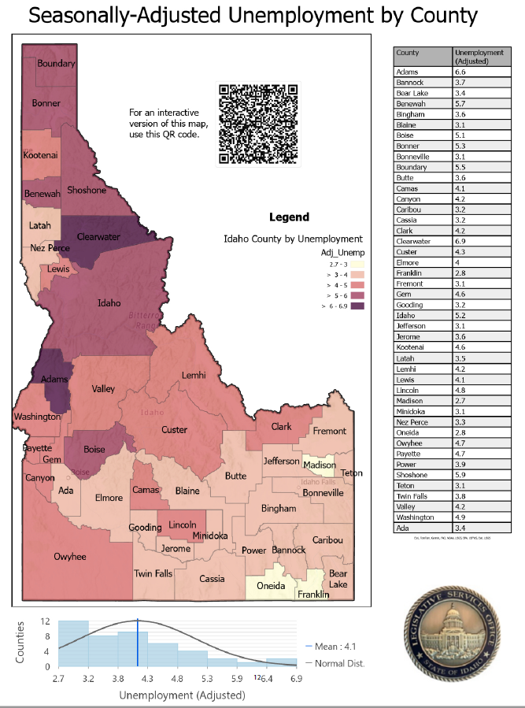
Demand Side Factors
Unemployment (Nov. 2024)*
Idaho-- 3.7%, up from 3.3% prior year
Bannock– 3.8%, up from 3.3%
Bingham– 3.8%, up from 3.1%
Bonneville– 3.2%, up from 2.6%
*Idaho Dept of Labor LAUS 2024 Revised and Preliminary Data
Updated 12/20/24
Notes:
Others who have or will address us today are better situated to discuss employment trends, but, while these have ticked up a bit, they are still quite low, in fact, there are some who believe that some loosening of the labor market may even bode well for economic growth

Slide 7
Demand Side Factors
Mortgage Interest Rates
Likely to remain well above 6%
10 Year Treasury Yield (not set by the Fed)
Inflation
Economic Growth
Market Sentiment
Fed Reserve Policy
Fiscal Policy
Mortgage rates have gone up since the Fed started cutting rates in Sept.

Slide 8
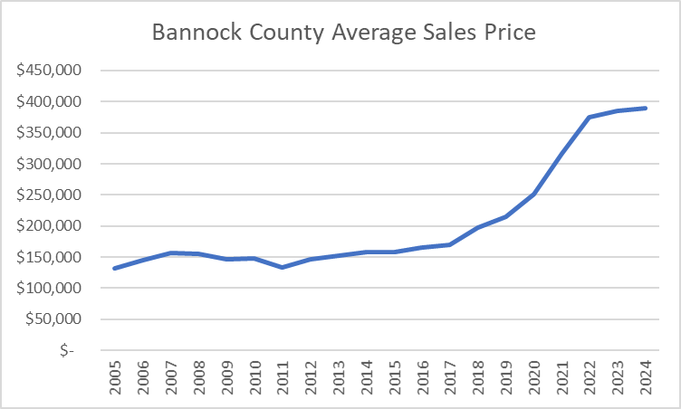
Demand Side Factors
Affordability
Bannock County 2024 Ave. Price-- $388k
Up from $215K in 2020– a 55% increase over 5 years
Source: Greg Johnston, REALTOR, (208) 680-4734

Slide 9
Demand Side Factors
Affordability (Cont.)
At this average price the down payment (20%--$78,000) is $27,000 larger than required 5 years ago
Income required to qualify for this loan (7% int, 30 years, 35% DTI) is $92,000/year
Bannock County median household income is $64,080
Income required to qualify for average home 5 years ago (@ 5% Interest) was $48,000

Slide 10
Demand Side Factors
Population Growth
Favorable Unemployment and Economic outlook
Relatively high but somewhat stable interest rates
Affordability

Slide 11
Supply Side Factors
2024 total home sales (820) are less than they have been since 2012
Active listings (168) are well below historical average (273)
New home sales (85) are essentially flat
Source: Greg Johnston, REALTOR, (208) 680-4734
Notes:
New home sales average is 72

Slide 12
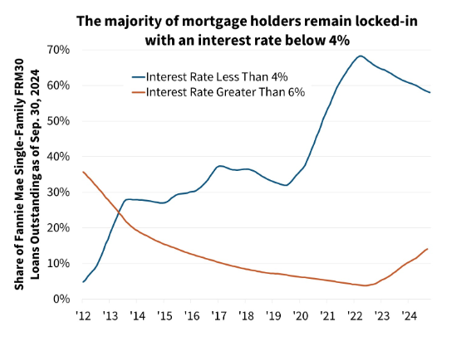
Supply Side Factors
Lock In Effect
Mortgage default rates (3.97%) are near or below historical levels
Source: Fannie Mae Economic Developments December 2024
5 Housing Market Predictions for 2025
Notes:
https://www.statista.com/statistics/205959/us-mortage-delinquency-rates-since-1990/
Share my own example
Ask a show of hands– how many of you have a mortgage below 3%

Slide 13
Supply Side Factors
Housing starts simply have not yet recovered from the 2008 crisis

Slide 14
Supply Side Factors
Multi-family Construction finally caught on here in Pocatello
Notes:
I can see this change in multi family units in my own rental business

Slide 15
Supply Side Factors
Existing Home Supply
New Housing Starts

Slide 16
Conclusion
Remember… I don’t know… but
Is it a bubble– Probably not
Demand side signals are mixed
Supply side issues are real
Things are likely to be pretty stable
What about other property types?
This is the key
When is the best time to buy real estate?
Notes:
Demand is likely to exceed supply, but it will mostly be pretty static– the demand side issues will work themselves out, but it will take time.

